Slide 1
Joint Radar-Communication Transmission: A Generalized Pareto Optimization Framework
  Authors : Li Chen, Fan Liu, Weidong Wang, Christos Masouros
  Publishers : IEEE Transactions on Signal Processing
  Date of Publication: 05 May 2021

Slide 2
Table of Contents
Abstract
Introduction
System Model
Joint Radar and Communication Optimization
Optimality Achieved by Single Transmission
Hardware-Impared Optimization

Slide 3
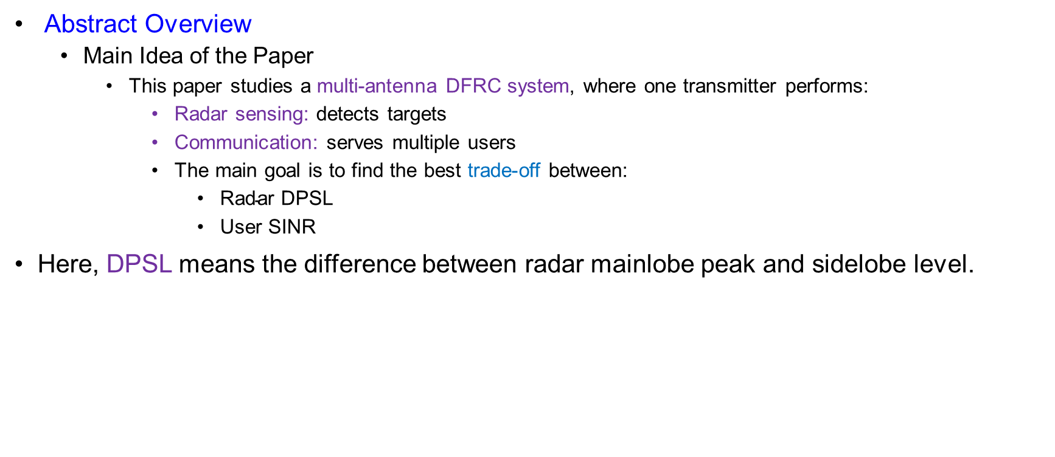
Abstract
Abstract Overview
  Main Idea of the Paper
    This paper studies a multi-antenna DFRC system, where one transmitter performs:
      Radar sensing: detects targets
      Communication: serves multiple users
      The main goal is to find the best trade-off between:
        $\text{Radar} \text{DPSL}$
        $\text{User} \text{SINR}$
Here, DPSL means the difference between radar mainlobe peak and sidelobe level.

Slide 4
Abstract
Key Contributions
  What This Paper Contributes
    The paper proposes a Pareto optimization framework for DFRC.
    Main contributions:
      Defines an achievable performance region using radar DPSL and user SINR.
      Proves this region is compact and normal.
      Uses fairness-profile optimization to find Pareto boundary points.
      Solves the problem using a bisection search algorithm.
      Shows optimal performance can be achieved by single-stream transmission.
      Extends the design to include hardware impairments.

Slide 5
Introduction
Motivation
  Why DFRC is needed
    Radar and communication systems increasingly use the same spectrum.
    Sub-6 GHz and mmWave bands are shared by both systems.
    Spectrum scarcity motivates joint radar-communication design.
Two Research Directions
  CRSS (Communication and radar spectrum sharing) has two main directions
    RCC: radar and communication are separate systems.
    DFRC: one system performs both radar sensing and communication.
  This paper focuses on DFRC.

Slide 6
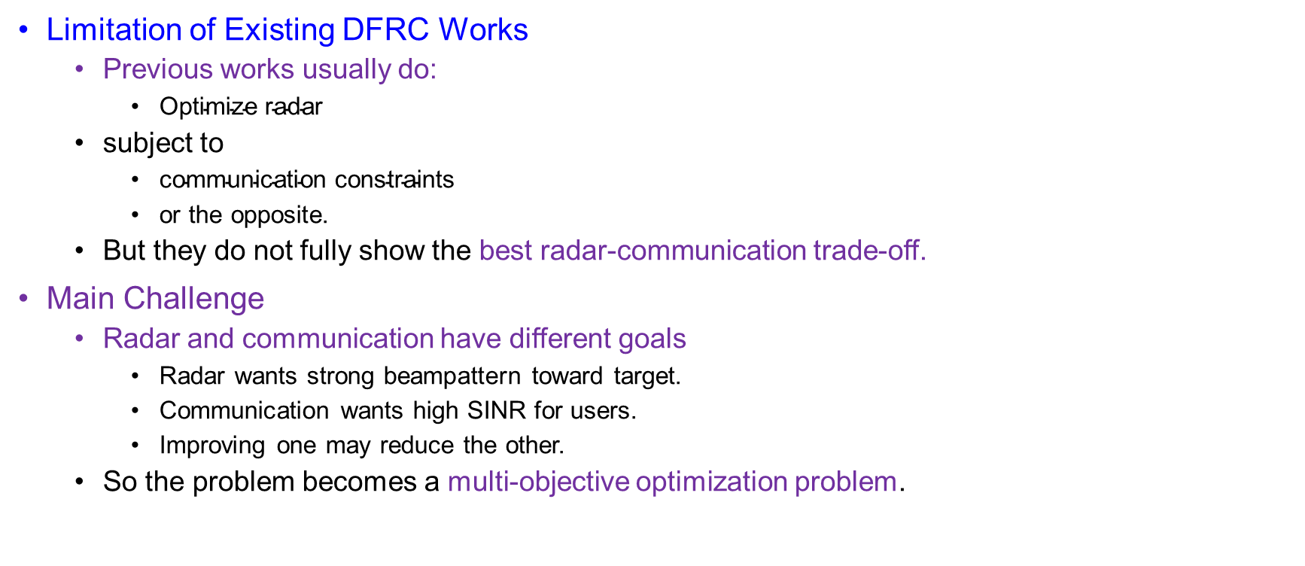
Introduction
Limitation of Existing DFRC Works
  Previous works usually do:
    $\text{Optimize} \text{radar}$
  subject to
    $\text{communication} \text{constraints}$
    or the opposite.
  But they do not fully show the best radar-communication trade-off.
Main Challenge
  Radar and communication have different goals
    Radar wants strong beampattern toward target.
    Communication wants high SINR for users.
    Improving one may reduce the other.
  So the problem becomes a multi-objective optimization problem.

Slide 7
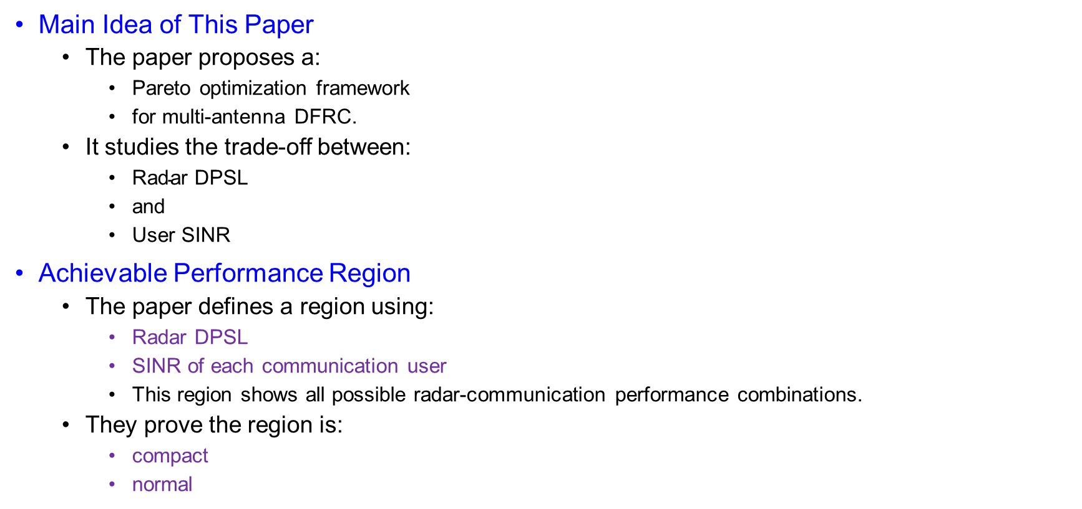
Introduction
Main Idea of This Paper
  The paper proposes a:
    Pareto optimization framework
    for multi-antenna DFRC.
  It studies the trade-off between:
    $\text{Radar} \text{DPSL}$
    and
    $\text{User} \text{SINR}$
Achievable Performance Region
  The paper defines a region using:
    Radar DPSL
    SINR of each communication user
    This region shows all possible radar-communication performance combinations.
  They prove the region is:
    compact
    normal

Slide 8
Introduction
Fairness-Profile Optimization
  The paper uses fairness-profile optimization.
Meaning:
  Radar and users have minimum acceptable performance.
  Then the design moves toward the Pareto boundary.
  This gives a balanced radar-communication trade-off.
  It includes both:
    max DPSL with SINR constraints
    max SINR with DPSL constraints
Main Contributions
  Key contributions
    Proposes Pareto framework for DFRC.
    Defines DPSL–SINR performance region.
    Solves the problem using bisection search.
    Proves single-stream transmission is optimal.
    Extends the design to hardware impairments.

Slide 9
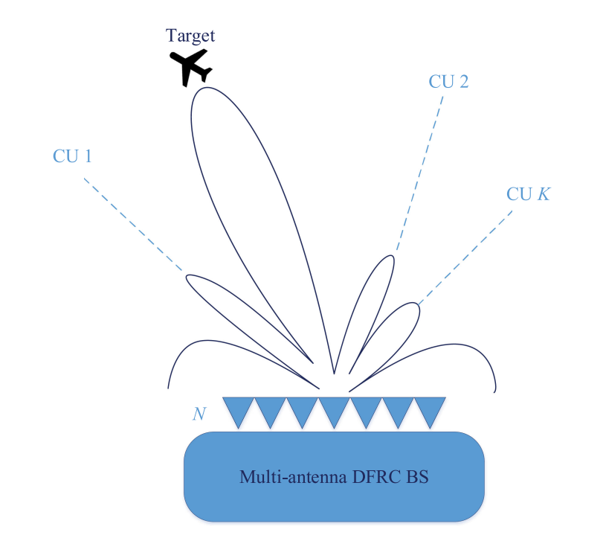
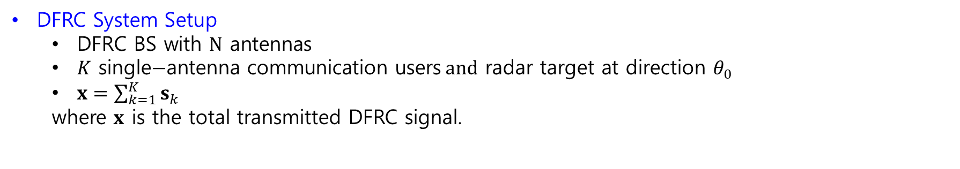
System Model
Fig. 1. System model of multi-antenna DFRC network
DFRC System Setup
  $\text{DFRC} \text{BS} \text{with} N \text{antennas}$
  $K \text{single}\text{−}\text{antenna} \text{communication} \text{users} and \text{radar} \text{target} \text{at} \text{direction} θ_{0}$
  $x=\sum_{k=1}^{K}{s_{k}}$
  where $x$ is the total transmitted DFRC signal.

Slide 10

System Model
DFRC System Setup
  Communication Received Signal
    Received signal of CU $k$
    $y_{k}=h_{k}^{H}x+z_{k}$
    Substitute:
    $x=\sum_{i=1}^{K}{s_{k}}$
    So:
    $y_{k}=h_{k}^{H}\sum_{i=1}^{K}{s_{k}}+z_{k}$
    Expand desired + interference:
    $y_{k}=\underset{\text{desired} \text{signal}}{\underbrace{h_{k}^{H}s_{k}}}+\underset{\text{multi}\text{−}\text{user} \text{interference}}{\underbrace{\sum_{i≠k}{h_{k}^{H}}s_{i}}}+\underset{\text{noise}}{\underbrace{z_{k}}}$

Slide 11

System Model
DFRC System Setup
  Signal Covariance Matrix
    Define:
    $S_{k}=E\left[s_{k}s_{k}^{H}\right]$
    Total transmit covariance:
    $E\left[xx^{H}\right]=E\left[\left.(\sum_{k=1}^{K}{s_{k}}\right){\left.(\sum_{i=1}^{K}{s_{k}}\right)}^{H}\right]$
    Because user’s signals are independent:
    $E\left[s_{k}s_{i}^{H}\right]=0, k≠i$
    Therefore:
    $E\left[xx^{H}\right]=\sum_{k=1}^{K}{S_{k}}$

Slide 12
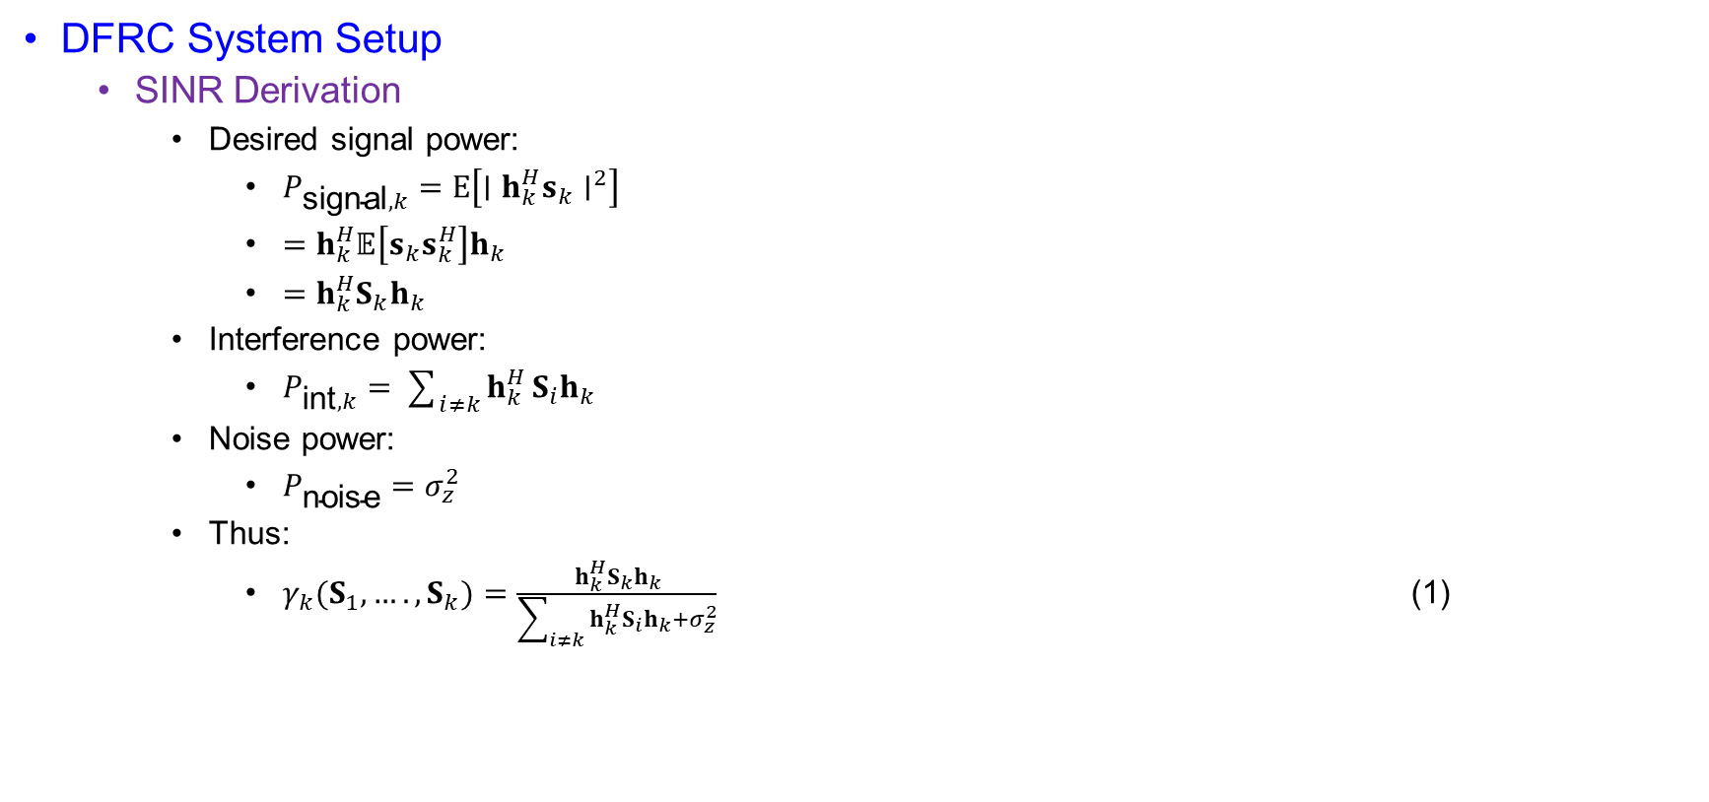
System Model
DFRC System Setup
  SINR Derivation
    Desired signal power:
      $P_{\text{signal},k}=E\left[∣h_{k}^{H}s_{k}∣^{2}\right]$
      $=h_{k}^{H}𝔼\left[s_{k}s_{k}^{H}\right]h_{k}$
      $=h_{k}^{H}S_{k}h_{k}$
    Interference power:
      $P_{\text{int},k}=\sum_{i≠k}{h_{k}^{H}}S_{i}h_{k}$
    Noise power:
      $P_{\text{noise}}=σ_{z}^{2}$
    Thus:
      $γ_{k}(S_{1},….,S_{k})=\frac{h_{k}^{H}S_{k}h_{k}}{\sum_{i≠k}{h_{k}^{H}}S_{i}h_{k}+σ_{z}^{2}}$ (1)

Slide 13

System Model
DFRC System Setup
  Transmit Power Constraint
  Total transmit power:
    $P_{\text{tx}}=E\left[∥x∥^{2}\right]$
    $=E\left[x^{H}x\right]$
  Using trace identity:
    $E\left[x^{H}x\right]=\operatorname{tr}\left(E\left[xx^{H}\right]\right)$
  Since:
    $E\left[xx^{H}\right]=\sum_{k=1}^{K}{S_{k}}$
  Then:
    $\operatorname{tr}\left.(\sum_{k=1}^{K}{S_{k}}\right)≤P_{0}$

Slide 14

System Model
DFRC System Setup
  Radar Probing Power
  Radar steering vector:
  $a\left(θ\right)={\left[1, e^{j2πdsin\left(θ\right)},……., e^{j2π\left(N−1\right)dsin\left(θ\right)}\right]}^{T}$
  Power radiated toward angle $θ$:
    $P_{\text{pro}}\left(θ\right)=a^{H}\left(θ\right)E\left[xx^{H}\right]a\left(θ\right)$
  Substitute covariance:
    $P_{\text{pro}}\left(θ\right)=a^{H}\left(θ\right)\left.(\sum_{k=1}^{K}{S_{k}}\right)a\left(θ\right)$

Slide 15

System Model
DFRC System Setup
  DPSL Radar Metric
  Main beam power:
    $P_{\text{main}}=P_{\text{pro}}\left(θ_{0}\right)$
    $=a^{H}\left(θ_{0}\right)\left.(\sum_{k=1}^{K}{S_{k}}\right)a\left(θ_{0}\right)$
  Sidelobe power at $θ_{m}$:
    $P_{\text{side},m}=P_{\text{pro}}\left(θ_{m}\right)$
    $=a^{H}\left(θ_{m}\right)\left.(\sum_{k=1}^{K}{S_{k}}\right)a\left(θ_{m}\right)$
  Therefore:
    $η_{m}=P_{\text{main}}−P_{\text{side},m}$
    $η_{m}=a^{H}\left(θ_{0}\right)\left.(\sum_{k=1}^{K}{S_{k}}\right)a\left(θ_{0}\right)−a^{H}\left(θ_{m}\right)\left.(\sum_{k=1}^{K}{S_{k}}\right)a\left(θ_{m}\right)$

Slide 16
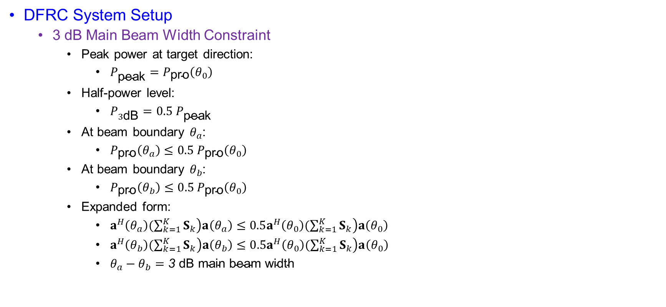
System Model
DFRC System Setup
  3 dB Main Beam Width Constraint
    Peak power at target direction:
      $P_{\text{peak}}=P_{\text{pro}}\left(θ_{0}\right)$
    Half-power level:
      $P_{3\text{dB}}=0.5 P_{\text{peak}}$
    At beam boundary $θ_{a}$:
      $P_{\text{pro}}\left(θ_{a}\right)≤0.5 P_{\text{pro}}\left(θ_{0}\right)$
    At beam boundary $θ_{b}$:
      $P_{\text{pro}}\left(θ_{b}\right)≤0.5 P_{\text{pro}}\left(θ_{0}\right)$
    Expanded form:
      $a^{H}\left(θ_{a}\right)\left.(\sum_{k=1}^{K}{S_{k}}\right)a\left(θ_{a}\right)≤0.5a^{H}\left(θ_{0}\right)\left.(\sum_{k=1}^{K}{S_{k}}\right)a\left(θ_{0}\right)$
      $a^{H}\left(θ_{b}\right)\left.(\sum_{k=1}^{K}{S_{k}}\right)a\left(θ_{b}\right)≤0.5a^{H}\left(θ_{0}\right)\left.(\sum_{k=1}^{K}{S_{k}}\right)a\left(θ_{0}\right)$
      $θ_{a}−θ_{b}=\text{3 }\text{dB} \text{main} \text{beam} \text{width}$

Slide 17
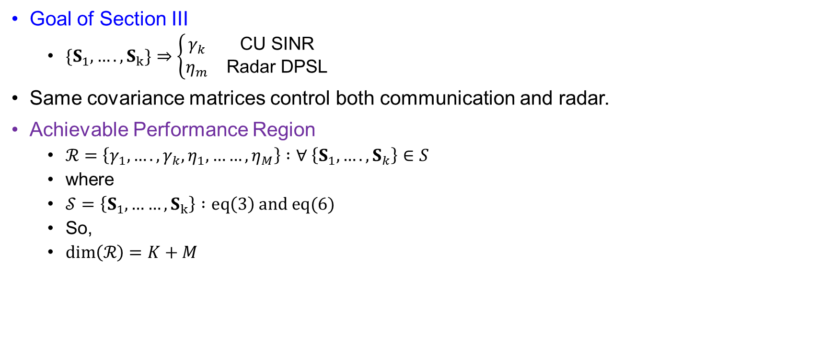
Joint Radar and Communication Optimization
Goal of Section III
  $\{S_{1},….,S_{k}\}⇒\left\{\begin{matrix}γ_{k} & \text{CU} \text{SINR} \\ η_{m} & \text{Radar} \text{DPSL}\end{matrix}\right.$
Same covariance matrices control both communication and radar.
Achievable Performance Region
  $ℛ=\left\{γ_{1},….,γ_{k},η_{1},……,η_{M}\right\} :∀ \left\{S_{1},….,S_{k}\right\}∈S$
  where
  $𝒮=\left\{S_{1},……,S_{k}\right\} :eq\left(3\right) and eq(6)$
  So,
  $dim⁡\left(ℛ\right)=K+M$

Slide 18
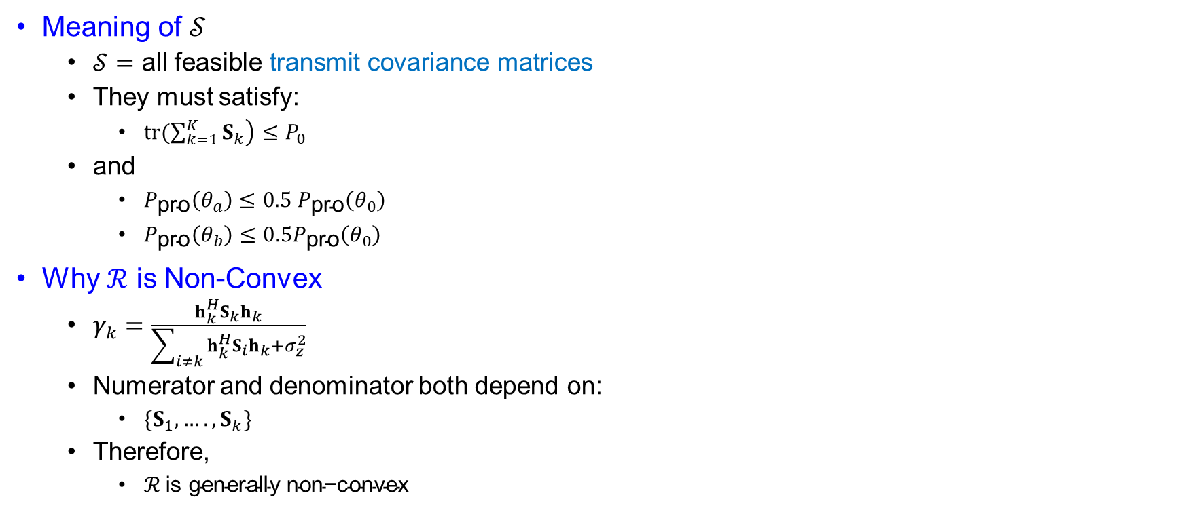
Joint Radar and Communication Optimization
Meaning of $𝒮$
  $𝒮=\text{all} \text{feasible} \text{transmit} \text{covariance} \text{matrices}$
  They must satisfy:
    $\operatorname{tr}\left.(\sum_{k=1}^{K}{S_{k}}\right)≤P_{0}$
  and
    $P_{\text{pro}}\left(θ_{a}\right)≤0.5{ P}_{\text{pro}}\left(θ_{0}\right)$
    $P_{\text{pro}}\left(θ_{b}\right)≤0.5P_{\text{pro}}\left(θ_{0}\right)$
Why $ℛ$ is Non-Convex
  $γ_{k}=\frac{h_{k}^{H}S_{k}h_{k}}{\sum_{i≠k}{h_{k}^{H}}S_{i}h_{k}+σ_{z}^{2}}$
  Numerator and denominator both depend on:
    $\{S_{1},….,S_{k}\}$
  Therefore,
    $ℛ \text{is} \text{generally} \text{non}\text{−}\text{convex}$

Slide 19
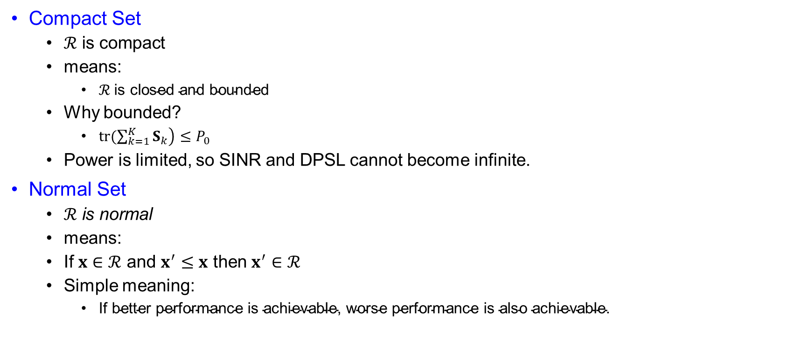
Joint Radar and Communication Optimization
Compact Set
  $ℛ \text{is} \text{compact}$
  means:
    $ℛ \text{is} \text{closed} \text{and} \text{bounded}$
  Why bounded?
    $\operatorname{tr}\left.(\sum_{k=1}^{K}{S_{k}}\right)≤P_{0}$
  Power is limited, so SINR and DPSL cannot become infinite.
Normal Set
  $ℛ \text{is} \text{normal}$
  means:
  If $x∈ℛ$ and $x^{′}≤x$ then $x^{′}∈ℛ$
  Simple meaning:
    $\text{If} \text{better} \text{performance} \text{is} \text{achievable}\text{, }\text{worse} \text{performance} \text{is} \text{also} \text{achievable}\text{.}$

Slide 20
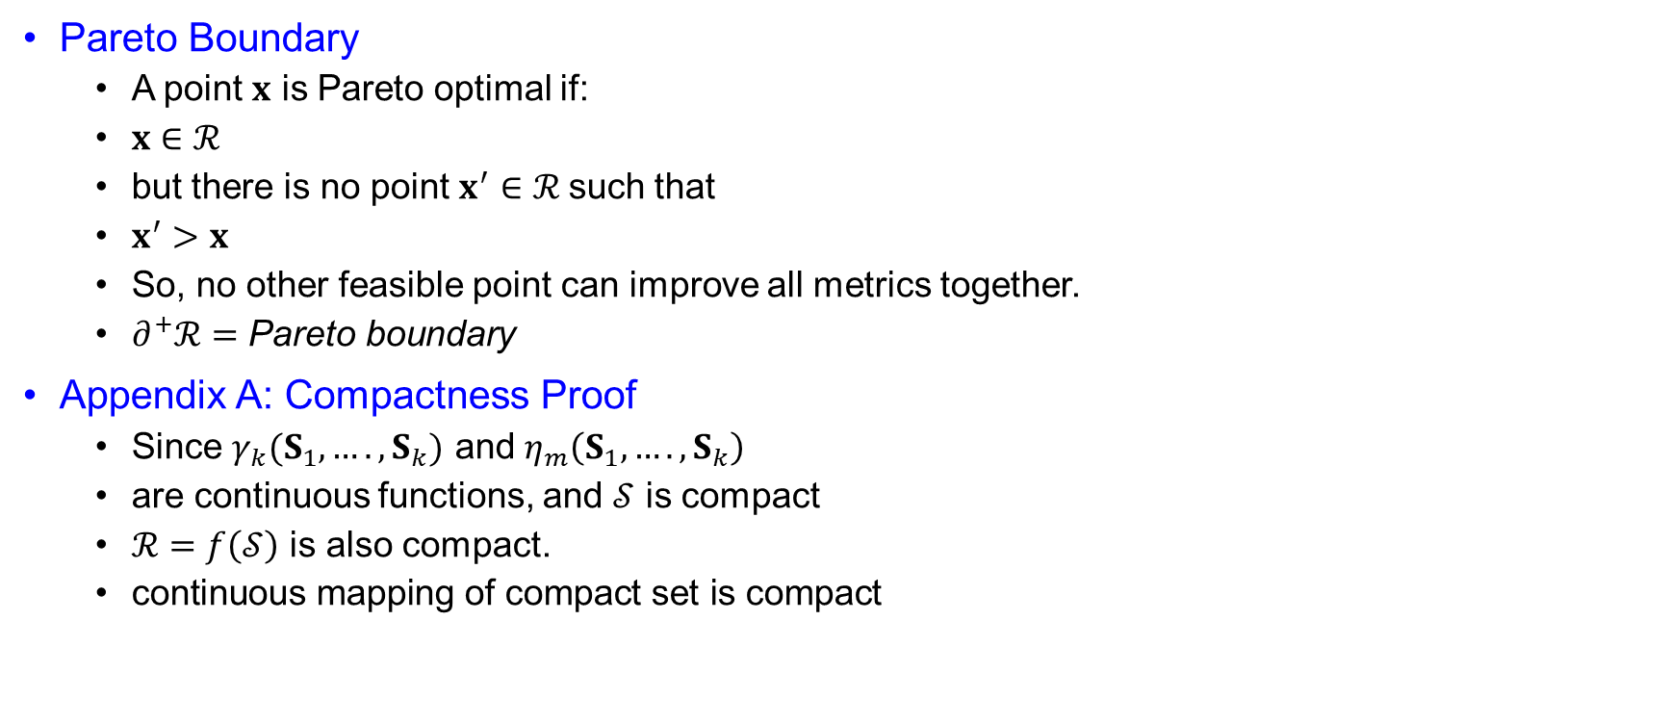
Joint Radar and Communication Optimization
Pareto Boundary
  A point $x$ is Pareto optimal if:
  $x∈ℛ$
  but there is no point $x^{′}∈ℛ$such that
  $x^{′}>x$
  So, no other feasible point can improve all metrics together.
  $∂^{+}ℛ=\text{Pareto} \text{boundary}$
Appendix A: Compactness Proof
  Since $γ_{k}(S_{1},….,S_{k})$ and $η_{m}\left(S_{1},….,S_{k}\right)$
  are continuous functions, and $𝒮$ is compact
  $ℛ=f\left(𝒮\right)$ is also compact.
  $\text{continuous} \text{mapping} \text{of} \text{compact} \text{set} \text{is} \text{compact}$

Slide 21
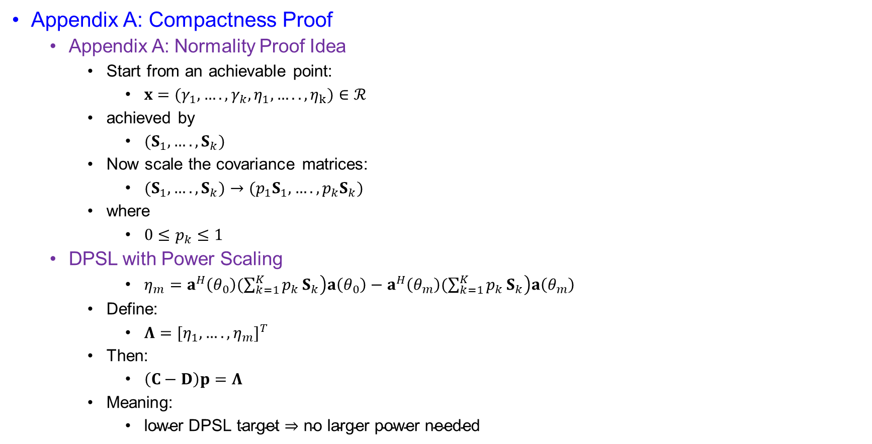
Joint Radar and Communication Optimization
Appendix A: Compactness Proof
  Appendix A: Normality Proof Idea
    Start from an achievable point:
      $x=(γ_{1},….,γ_{k}, η_{1},…..,η_{k})∈ℛ$
    achieved by
      $(S_{1},….,S_{k})$
    Now scale the covariance matrices:
      $(S_{1},….,S_{k})→({p_{1}S}_{1},….,p_{k}S_{k})$
    where
      $0≤p_{k}≤1$
  DPSL with Power Scaling
      $η_{m}=a^{H}\left(θ_{0}\right)\left.(\sum_{k=1}^{K}{p_{k}}S_{k}\right)a\left(θ_{0}\right)−a^{H}\left(θ_{m}\right)\left.(\sum_{k=1}^{K}{p_{k}}S_{k}\right)a\left(θ_{m}\right)$
    Define:
      $Λ={[η_{1},….,η_{m}]}^{T}$
    Then:
      $\left(C−D\right)p=Λ$
    Meaning:
      $\text{lower} \text{DPSL} \text{target}⇒\text{no} \text{larger} \text{power} \text{needed}$

Slide 22

Joint Radar and Communication Optimization
Conclusion
  If $x∈ℛ$ and $x^{′}≤x$
  then by reducing/scaling transmit covariance power
  $x^{′}∈ℛ$
  Therefore:
    $ℛ$ is normal
  Together:
    $ℛ$ is normal and compact
  So, the best DFRC trade-off points lie on:
    $∂^{+}ℛ$

Slide 23
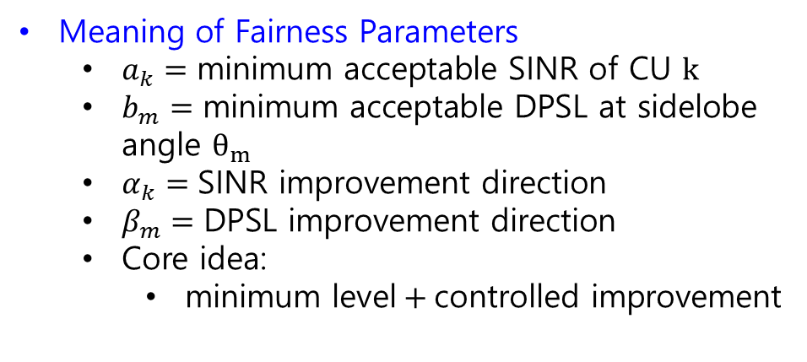
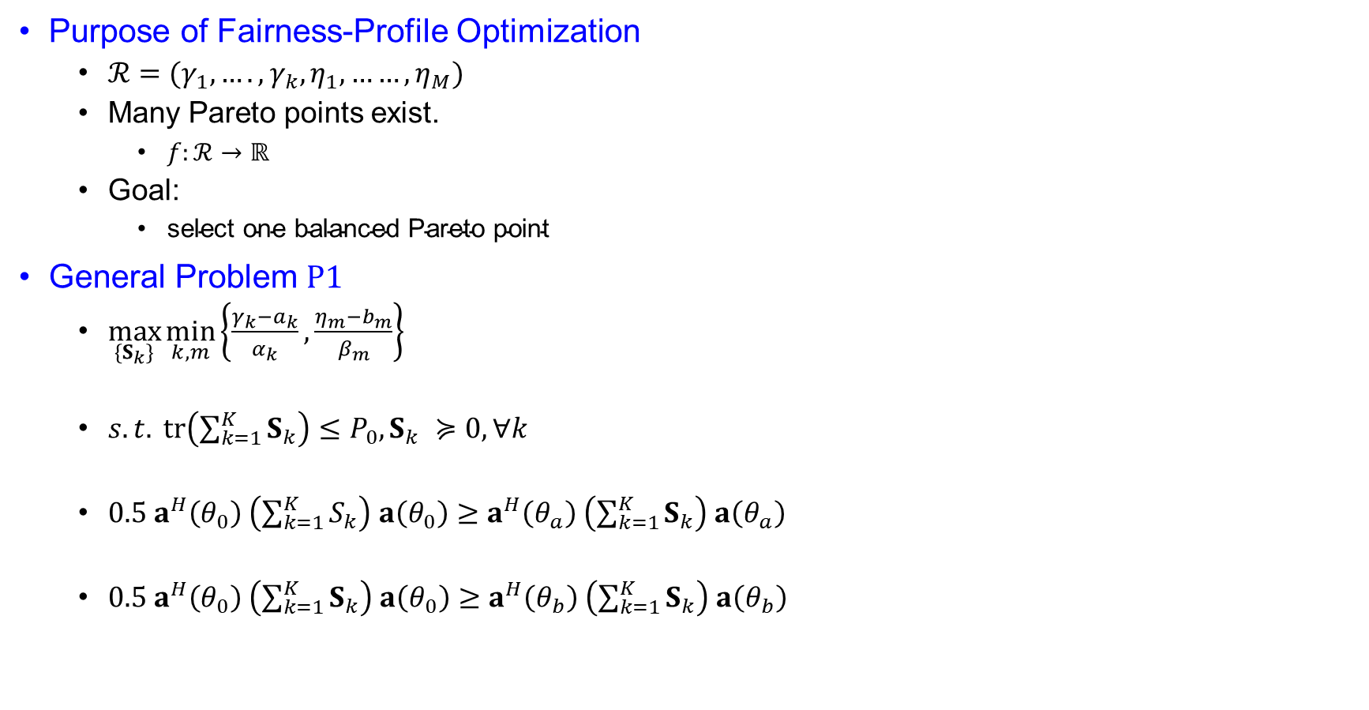
Joint Radar and Communication Optimization
Purpose of Fairness-Profile Optimization
  $ℛ=(γ_{1},….,γ_{k},η_{1},……,η_{M})$
  Many Pareto points exist.
    $f:ℛ→ℝ$
  Goal:
    $\text{select} \text{one} \text{balanced} \text{Pareto} \text{point}$
General Problem $P1$
  $\max_{\{S_{k}\}}{\min_{k,m}\left\{\frac{γ_{k}−a_{k}}{α_{k}}, \frac{η_{m}−b_{m}}{β_{m}}\right\}}$
  $s.t. tr\left(\sum_{k=1}^{K}{S_{k}}\right)≤P_{0}, S_{k} ≽0, ∀k$
  $0.5 a^{H}\left(θ_{0}\right) \left(\sum_{k=1}^{K}{S_{k}}\right) a\left(θ_{0}\right)≥a^{H}\left(θ_{a}\right) \left(\sum_{k=1}^{K}{S_{k}}\right) a\left(θ_{a}\right)$
  $0.5 a^{H}\left(θ_{0}\right) \left(\sum_{k=1}^{K}{S_{k}}\right) a\left(θ_{0}\right)≥a^{H}\left(θ_{b}\right) \left(\sum_{k=1}^{K}{S_{k}}\right) a\left(θ_{b}\right)$
Meaning of Fairness Parameters
  $a_{k}=\text{minimum} \text{acceptable} \text{SINR} \text{of} \text{CU} k$
  $b_{m}=\text{minimum} \text{acceptable} \text{DPSL} \text{at} \text{sidelobe} \text{angle} θ_{m}$
  $α_{k}=\text{SINR} \text{improvement} \text{direction}$
  $β_{m}=\text{DPSL} \text{improvement} \text{direction}$
  Core idea:
    $\text{minimum} \text{level}+\text{controlled} \text{improvement}$

Slide 24

Joint Radar and Communication Optimization
General Problem $P1$
  Remark 2: Radar-Priority Case
    Set:
      $a_{k}=Γ_{k}, α_{k}=δ$
      $b_{m}=0, β_{m}=1$
    Then:
      $f=\min_{k,m}\left\{\frac{γ_{k}−Γ_{k}}{δ} , η_{m}\right\}$
    As
      $δ→0$
    the SINR constraints become dominant.

Slide 25

Joint Radar and Communication Optimization
From $P1$ to $P1.1$
  To avoid a very negative utility:
    $γ_{k}≥Γ_{k}, ∀k$
  After satisfying SINR constraints:
    $\max_{\left\{S_{k}\right\}} \min_{m}η_{m}$
  So,
    $P1.1:\max_{\left\{S_{k}\right\}}\min_{m}{ η}_{m}$
  subject to:
    $γ_{k}≥Γ_{k}, ∀k$
  Meaning:
    $\text{maximize} \text{worst} \text{radar} \text{DPSL}$
    while guaranteeing:
      $\text{e}\text{ach} \text{user}\text{’}\text{s} \text{SINR} \text{requirement}$
      This is a radar-priority DFRC design.

Slide 26

Joint Radar and Communication Optimization
From $P1$ to $P1.2$
  Remark 3: Communication-Priority Case
    Set:
      $a_{k}=0, α_{k}=1$
      $b_{m}=Λ_{m}, β_{m}=δ$
      Then:
        $f=\min_{k,m}\left\{γ_{k} , \frac{η_{m}−Λ_{m}}{δ}\right\}$
    As
      $δ→0$
    the DPSL constraints become dominant.

Slide 27

Joint Radar and Communication Optimization
From $P1$ to $P1.2$
  $P1.2:\max_{\left\{S_{k}\right\}}\min_{k}{ γ}_{k}$
  with:
    $η_{m}≥Λ_{m}$
  Meaning:
    $\text{maximize} \text{worst} \text{user} \text{SINR}$
    while guaranteeing:
    $\text{radar} \text{DPSL} \text{requirements}$
    This is a communication-priority DFRC design.

Slide 28
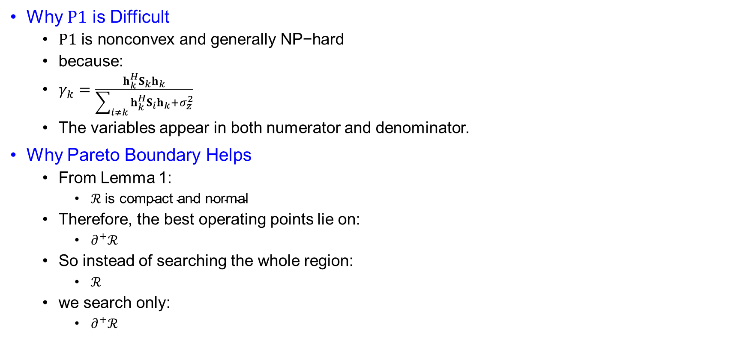
Joint Radar and Communication Optimization
Why $P1$ is Difficult
  $P1 \text{is} \text{nonconvex} \text{and} \text{generally} \text{NP}\text{−}\text{hard}$
  because:
  $γ_{k}=\frac{h_{k}^{H}S_{k}h_{k}}{\sum_{i≠k}{h_{k}^{H}}S_{i}h_{k}+σ_{z}^{2}}$
  The variables appear in both numerator and denominator.
Why Pareto Boundary Helps
  From Lemma 1:
    $ℛ \text{is} \text{compact} \text{and} \text{normal}$
  Therefore, the best operating points lie on:
    $∂^{+}ℛ$
  So instead of searching the whole region:
    $ℛ$
  we search only:
    $∂^{+}ℛ$

Slide 29
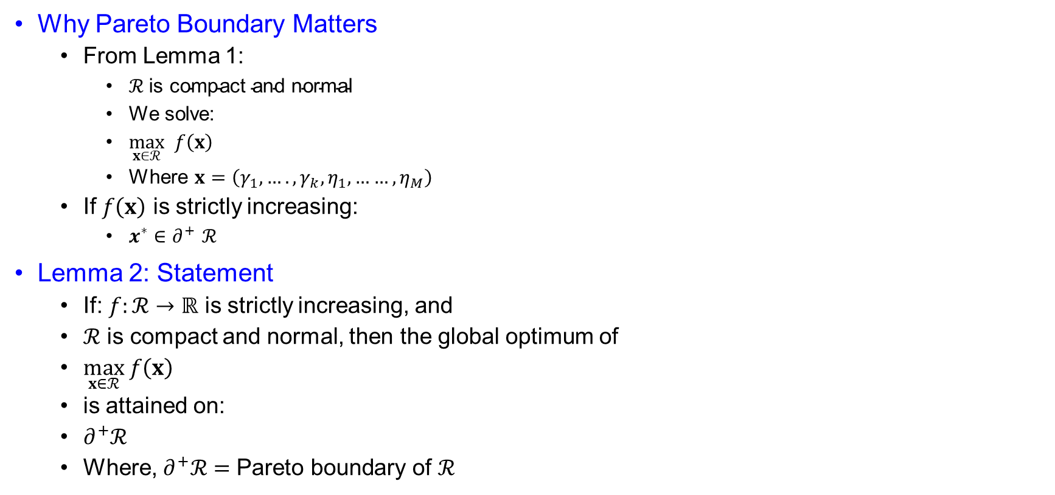
Joint Radar and Communication Optimization
Why Pareto Boundary Matters
  From Lemma 1:
    $ℛ \text{is} \text{compact} \text{and} \text{normal}$
    We solve:
    $\max_{x∈ℛ} f\left(x\right)$
    Where $x=\left(γ_{1},….,γ_{k},η_{1},……,η_{M}\right)$
  If $f\left(x\right)$ is strictly increasing:
    $x^{∗}∈∂^{+}$ $ℛ$
Lemma 2: Statement
  If: $f:ℛ→ℝ$ is strictly increasing, and
  $ℛ$ is compact and normal, then the global optimum of
  $\max_{x∈ℛ} f\left(x\right)$
  is attained on:
  $∂^{+}ℛ$
  Where, $∂^{+}ℛ=\text{Pareto} \text{boundary} \text{of} ℛ$

Slide 30
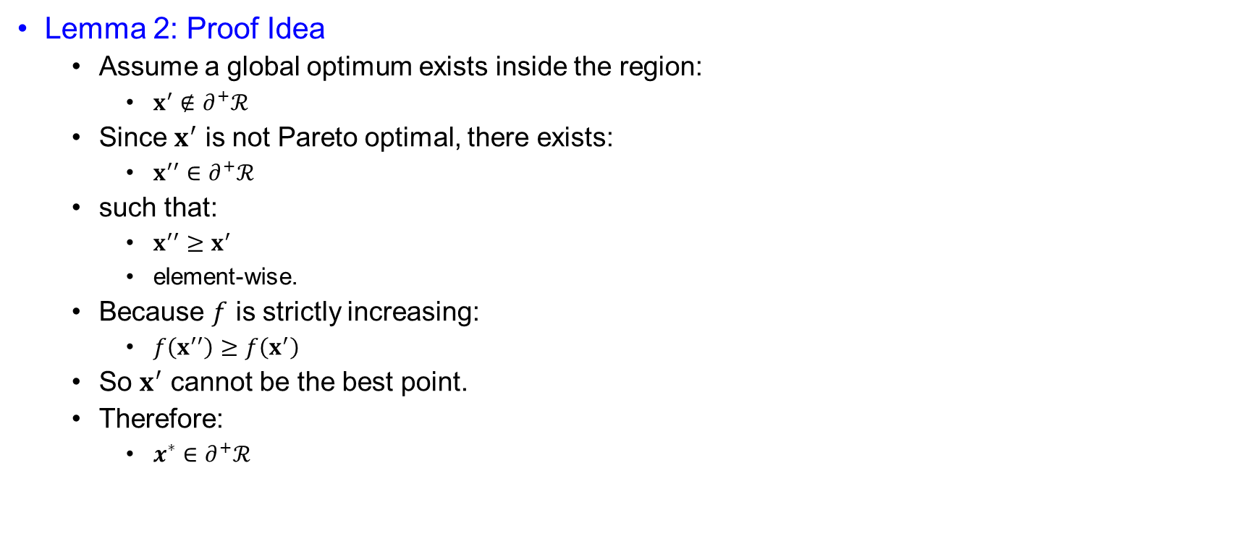
Joint Radar and Communication Optimization
Lemma 2: Proof Idea
  Assume a global optimum exists inside the region:
    $x^{′}∉∂^{+}ℛ$
  Since $x^{′}$ is not Pareto optimal, there exists:
    $x^{′′}∈∂^{+}ℛ$
  such that:
    $x^{′′}≥x^{′}$
    element-wise.
  Because $f$ is strictly increasing:
    $f\left(x^{′′}\right)≥f\left(x^{′}\right)$
  So $x^{′}$ cannot be the best point.
  Therefore:
    $x^{∗}∈∂^{+}ℛ$

Slide 31
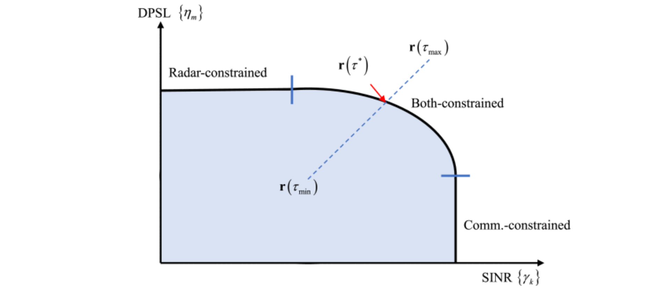

Joint Radar and Communication Optimization
From Fairness Profile to Ray Search
  Previous utility:
    $f=\min_{k,m}\left\{\frac{γ_{k}−a_{k}}{α_{k}} , \frac{η_{m}−b_{m}}{β_{m}}\right\}$
  Let the common improvement level be:
    $τ$ Then:
    $\frac{γ_{k}−a_{k}}{α_{k}}≥τ$
    $⇒γ_{k}≥a_{k}+α_{k}τ$
  and
    $\frac{η_{m}−b_{m}}{β_{m}}≥τ$
    $⇒η_{m}≥b_{m}+β_{m}τ$
Fig. 2. Illustration of bisection search on the pareto boundary of achievable performance.

Slide 32
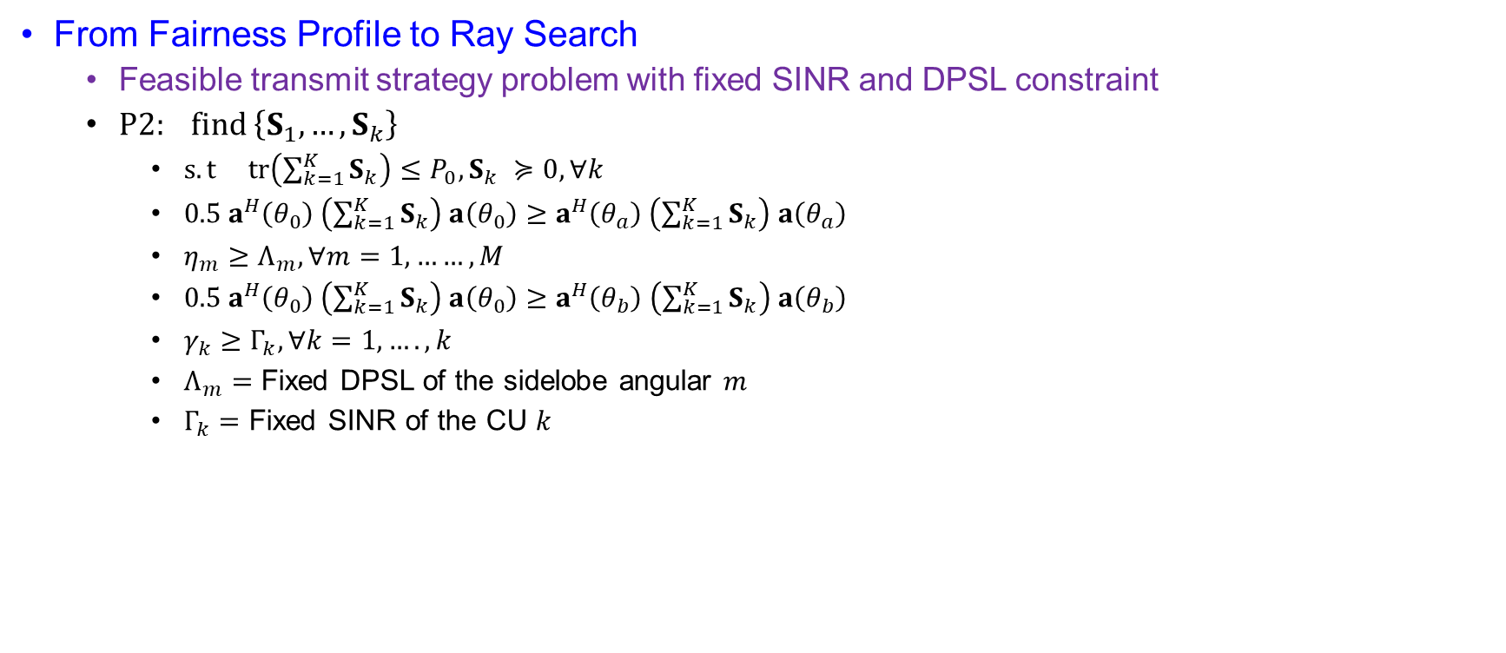
Joint Radar and Communication Optimization
From Fairness Profile to Ray Search
  Feasible transmit strategy problem with fixed SINR and DPSL constraint
  $P2: find \left\{S_{1},…,S_{k}\right\}$
    $s.t tr\left(\sum_{k=1}^{K}{S_{k}}\right)≤P_{0}, S_{k} ≽0, ∀k$
    $0.5 a^{H}\left(θ_{0}\right) \left(\sum_{k=1}^{K}{S_{k}}\right) a\left(θ_{0}\right)≥a^{H}\left(θ_{a}\right) \left(\sum_{k=1}^{K}{S_{k}}\right) a\left(θ_{a}\right)$
    $η_{m}≥Λ_{m}, ∀m=1,……,M$
    $0.5 a^{H}\left(θ_{0}\right) \left(\sum_{k=1}^{K}{S_{k}}\right) a\left(θ_{0}\right)≥a^{H}\left(θ_{b}\right) \left(\sum_{k=1}^{K}{S_{k}}\right) a\left(θ_{b}\right)$
    $γ_{k}≥Γ_{k}, ∀k=1,….,k$
    $Λ_{m}=$ Fixed DPSL of the sidelobe angular $m$
    $Γ_{k}=$ Fixed SINR of the CU $k$

Slide 33
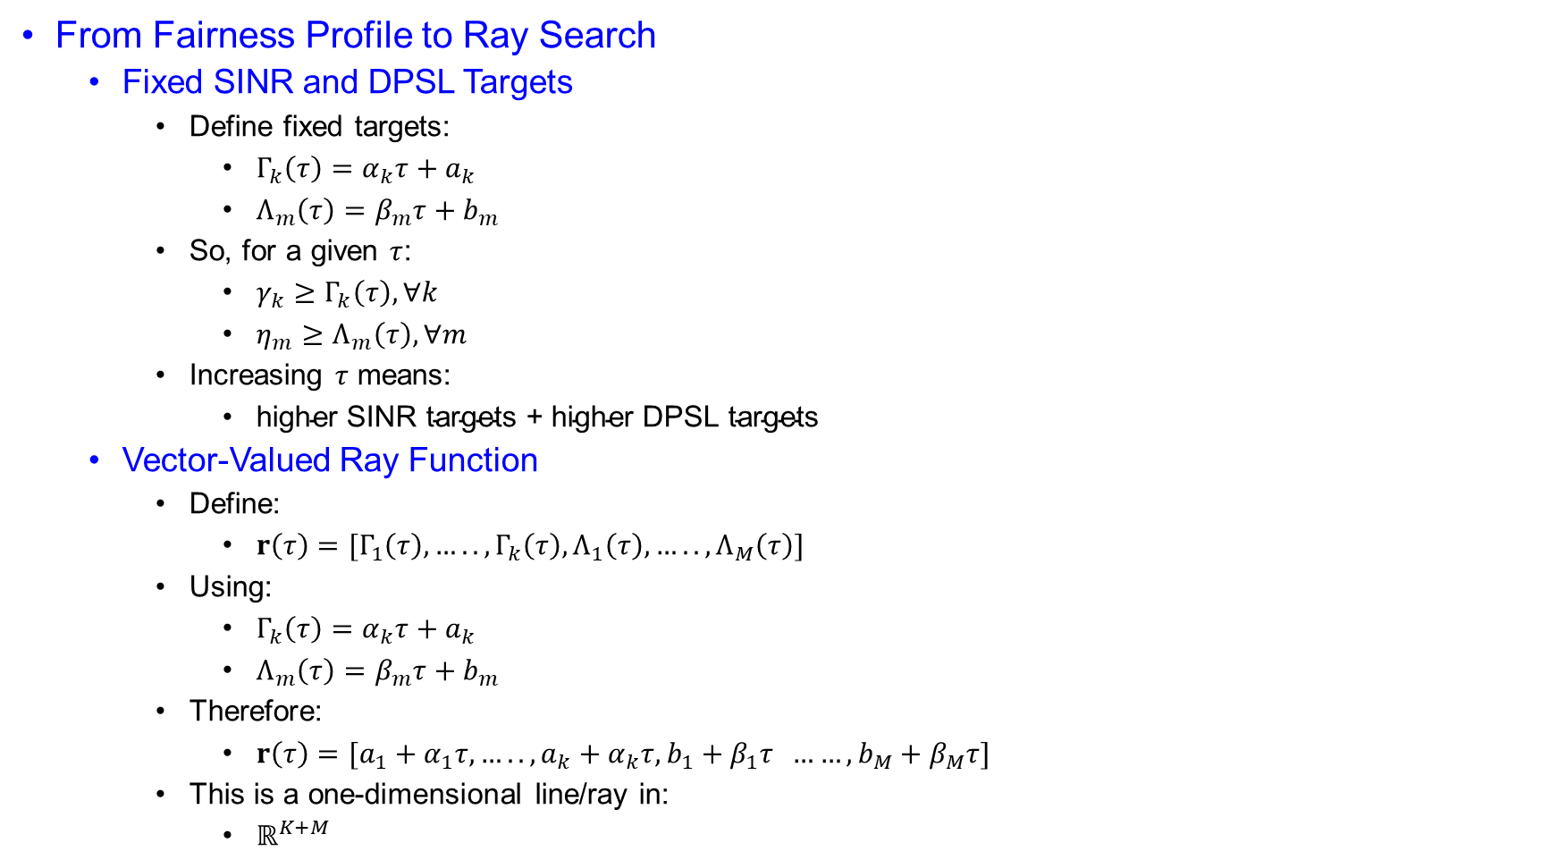
Joint Radar and Communication Optimization
From Fairness Profile to Ray Search
  Fixed SINR and DPSL Targets
    Define fixed targets:
      $Γ_{k}\left(τ\right)=α_{k}τ+a_{k}$
      $Λ_{m}\left(τ\right)=β_{m}τ+b_{m}$
    So, for a given $τ$:
      $γ_{k}≥Γ_{k}\left(τ\right), ∀k$
      $η_{m}≥Λ_{m}\left(τ\right), ∀m$
    Increasing $τ$ means:
      $\text{higher} \text{SINR} \text{targets}\text{ + }\text{higher} \text{DPSL} \text{targets}$
  Vector-Valued Ray Function
    Define:
      $r\left(τ\right)=[Γ_{1}\left(τ\right),….., Γ_{k}\left(τ\right), Λ_{1}\left(τ\right), …..,Λ_{M}\left(τ\right)]$
    Using:
      $Γ_{k}\left(τ\right)=α_{k}τ+a_{k}$
      $Λ_{m}\left(τ\right)=β_{m}τ+b_{m}$
    Therefore:
      $r\left(τ\right)=[a_{1}+α_{1}τ,….., a_{k}+α_{k}τ, b_{1}+β_{1}τ ……,b_{M}+β_{M}τ]$
    This is a one-dimensional line/ray in:
      $ℝ^{K+M}$

Slide 34
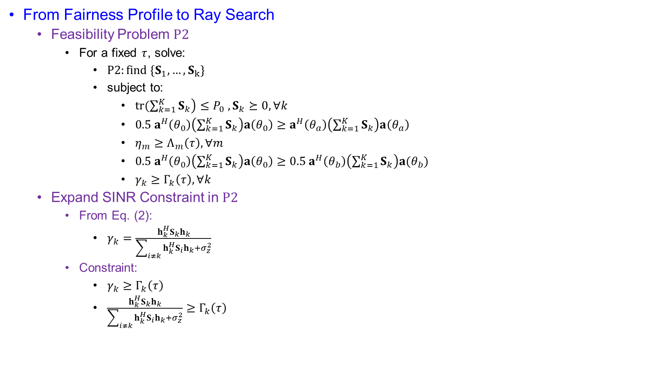
Joint Radar and Communication Optimization
From Fairness Profile to Ray Search
  Feasibility Problem $P2$
    For a fixed $τ$, solve:
      $P2:find \{S_{1},…, S_{k}\}$
      subject to:
        $\operatorname{tr}\left.(\sum_{k=1}^{K}{S_{k}}\right)≤P_{0} , S_{k}⪰0, ∀k$
        $0.5 a^{H}\left(θ_{0}\right)\left(\sum_{k=1}^{K}{S_{k}}\right)a\left(θ_{0}\right)≥a^{H}\left(θ_{a}\right)\left(\sum_{k=1}^{K}{S_{k}}\right)a\left(θ_{a}\right)$
        $η_{m}≥Λ_{m}\left(τ\right), ∀m$
        $0.5 a^{H}\left(θ_{0}\right)\left(\sum_{k=1}^{K}{S_{k}}\right)a\left(θ_{0}\right)≥0.5 a^{H}\left(θ_{b}\right)\left(\sum_{k=1}^{K}{S_{k}}\right)a(θ_{b})$
        $γ_{k}≥Γ_{k}\left(τ\right), ∀k$
  Expand SINR Constraint in $P2$
    From Eq. (2):
      $γ_{k}=\frac{h_{k}^{H}S_{k}h_{k}}{\sum_{i≠k}{h_{k}^{H}}S_{i}h_{k}+σ_{z}^{2}}$
    Constraint:
      $γ_{k}≥Γ_{k}\left(τ\right)$
      $\frac{h_{k}^{H}S_{k}h_{k}}{\sum_{i≠k}{h_{k}^{H}}S_{i}h_{k}+σ_{z}^{2}}≥Γ_{k}\left(τ\right)$

Slide 35
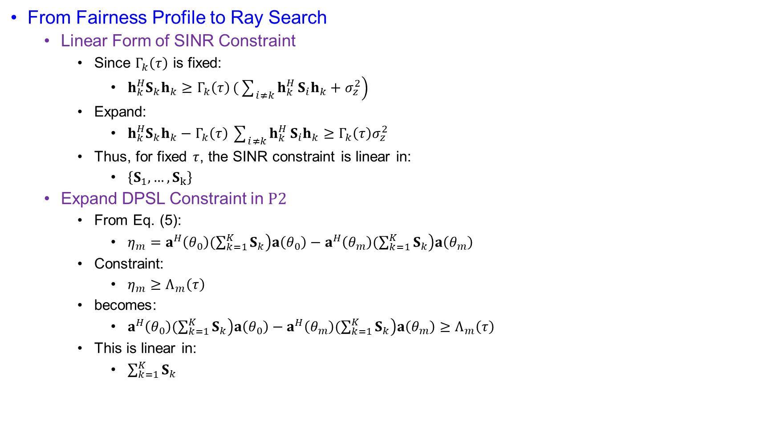
Joint Radar and Communication Optimization
From Fairness Profile to Ray Search
  Linear Form of SINR Constraint
    Since $Γ_{k}\left(τ\right)$ is fixed:
      $h_{k}^{H}S_{k}h_{k}≥Γ_{k}\left(τ\right)\left.(\sum_{i≠k}{h_{k}^{H}}S_{i}h_{k}+σ_{z}^{2}\right)$
    Expand:
      $h_{k}^{H}S_{k}h_{k}−Γ_{k}\left(τ\right)\sum_{i≠k}{h_{k}^{H}}S_{i}h_{k}≥Γ_{k}\left(τ\right)σ_{z}^{2}$
    Thus, for fixed $τ$, the SINR constraint is linear in:
      $\left\{S_{1},…, S_{k}\right\}$
  Expand DPSL Constraint in $P2$
    From Eq. (5):
      $η_{m}=a^{H}\left(θ_{0}\right)\left.(\sum_{k=1}^{K}{S_{k}}\right)a\left(θ_{0}\right)−a^{H}\left(θ_{m}\right)\left.(\sum_{k=1}^{K}{S_{k}}\right)a\left(θ_{m}\right)$
    Constraint:
      $η_{m}≥Λ_{m}\left(τ\right)$
    becomes:
      $a^{H}\left(θ_{0}\right)\left.(\sum_{k=1}^{K}{S_{k}}\right)a\left(θ_{0}\right)−a^{H}\left(θ_{m}\right)\left.(\sum_{k=1}^{K}{S_{k}}\right)a\left(θ_{m}\right)≥Λ_{m}\left(τ\right)$
    This is linear in:
      $\sum_{k=1}^{K}{S_{k}}$

Slide 36
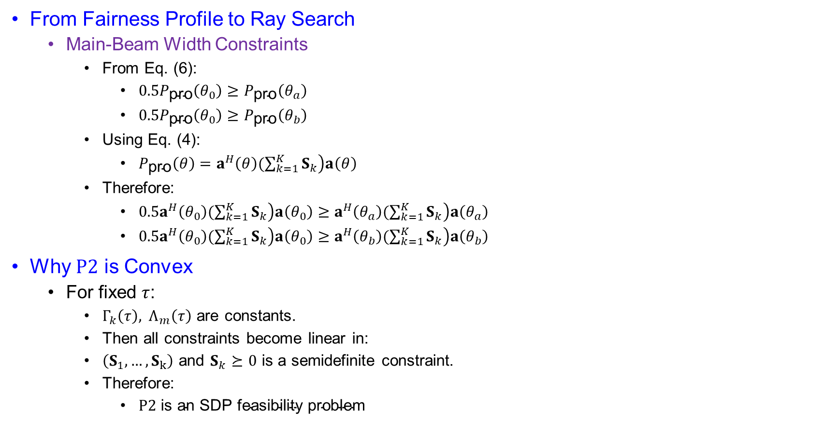
Joint Radar and Communication Optimization
From Fairness Profile to Ray Search
  Main-Beam Width Constraints
    From Eq. (6):
      $0.5P_{\text{pro}}\left(θ_{0}\right)≥P_{\text{pro}}\left(θ_{a}\right)$
      $0.5P_{\text{pro}}\left(θ_{0}\right)≥P_{\text{pro}}\left(θ_{b}\right)$
    Using Eq. (4):
      $P_{\text{pro}}\left(θ\right)=a^{H}\left(θ\right)\left.(\sum_{k=1}^{K}{S_{k}}\right)a\left(θ\right)$
    Therefore:
      $0.5a^{H}\left(θ_{0}\right)\left.(\sum_{k=1}^{K}{S_{k}}\right)a\left(θ_{0}\right)≥a^{H}\left(θ_{a}\right)\left.(\sum_{k=1}^{K}{S_{k}}\right)a\left(θ_{a}\right)$
      $0.5a^{H}\left(θ_{0}\right)\left.(\sum_{k=1}^{K}{S_{k}}\right)a\left(θ_{0}\right)≥a^{H}\left(θ_{b}\right)\left.(\sum_{k=1}^{K}{S_{k}}\right)a\left(θ_{b}\right)$
Why $P2$ is Convex
  For fixed $τ$:
    $Γ_{k}\left(τ\right), Λ_{m}\left(τ\right)$ are constants.
    Then all constraints become linear in:
    $\left(S_{1},…, S_{k}\right)$ and $S_{k}⪰0$ is a semidefinite constraint.
    Therefore:
      $P2 \text{is} \text{an} \text{SDP} \text{feasibility} \text{problem}$

Slide 37
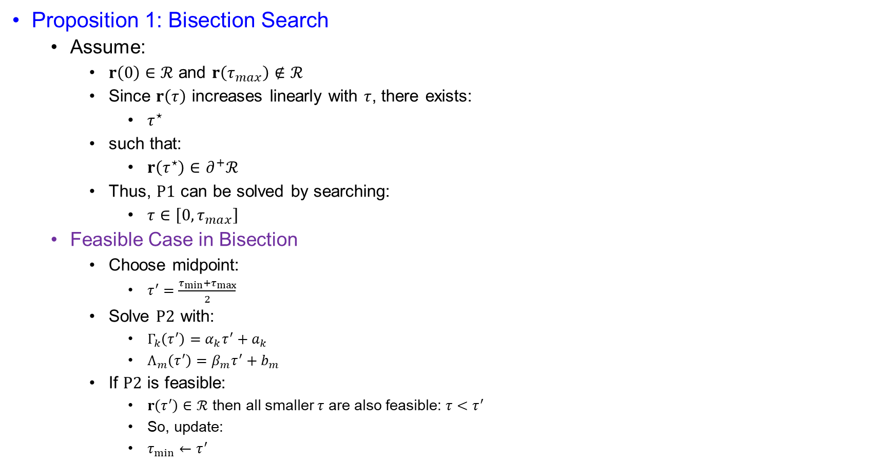
Joint Radar and Communication Optimization
Proposition 1: Bisection Search
  Assume:
    $r\left(0\right)∈ℛ$ and $r\left(τ_{max}\right)∉ℛ$
    Since $r\left(τ\right)$ increases linearly with $τ$, there exists:
      $τ^{⋆}$
    such that:
      $r\left(τ^{⋆}\right)∈∂^{+}ℛ$
    Thus, $P1$ can be solved by searching:
      $τ∈\left[0, τ_{max}\right]$
  Feasible Case in Bisection
    Choose midpoint:
      $τ^{′}=\frac{τ_{min}+τ_{max}}{2}$
    Solve $P2$ with:
      $Γ_{k}\left(τ^{′}\right)=α_{k}τ^{′}+a_{k}$
      $Λ_{m}\left(τ^{′}\right)=β_{m}τ^{′}+b_{m}$
    If $P2$ is feasible:
      $r\left(τ^{′}\right)∈ℛ$ then all smaller $τ$ are also feasible: $τ<τ^{′}$
      So, update:
      $τ_{min}←τ^{′}$

Slide 38

Joint Radar and Communication Optimization
Proposition 1: Bisection Search
  Infeasible Case in Bisection
    If $P2$ is infeasible:
      $r\left(τ^{′}\right)∉ℛ$
      Then $τ^{′}$ is too demanding.
    All larger $τ$ are also infeasible:
      $τ>τ^{′}$
    So update:
      $τ_{max}←τ^{′}$
    Continue until:
      $∣τ^{\left(t\right)}−τ^{\left(t−1\right)}∣<Δ$

Slide 39

Joint Radar and Communication Optimization
Proposition 1: Bisection Search
  Final Solution
    After convergence:
      $τ^{⋆}$
    defines the Pareto point:
      $r\left(τ^{∗}\right)=[Γ_{1}\left(τ^{∗}\right),….., Γ_{k}\left(τ^{∗}\right), Λ_{1}\left(τ^{∗}\right), …..,Λ_{M}\left(τ^{∗}\right)]$
    Then solve $P2$ one final time to obtain:
      $\{S_{1}^{∗},…..,S_{k}^{∗}\}$
    These covariance matrices achieve the selected Pareto-optimal DFRC operating point.

Slide 40
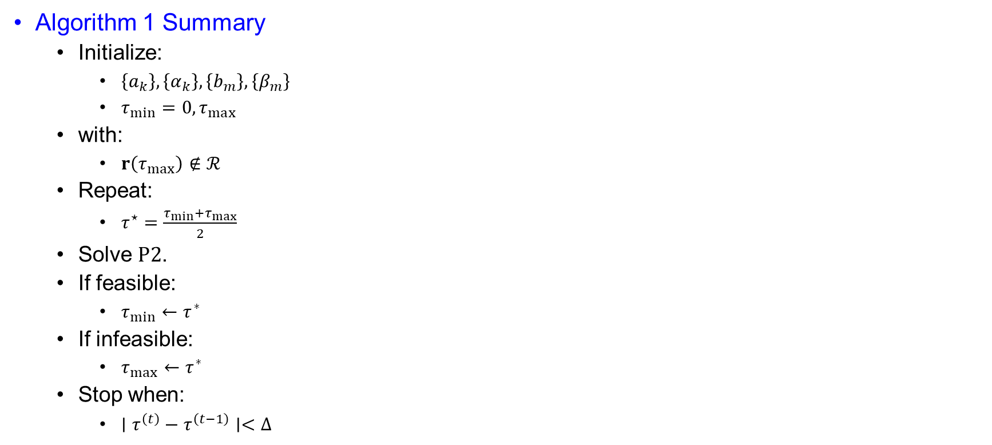
Joint Radar and Communication Optimization
Algorithm 1 Summary
  Initialize:
    $\left\{a_{k}\right\},\left\{α_{k}\right\},\left\{b_{m}\right\},\left\{β_{m}\right\}$
    $τ_{min}=0, τ_{max}$
  with:
    $r\left(τ_{max}\right)∉ℛ$
  Repeat:
    $τ^{⋆}=\frac{τ_{min}+τ_{max}}{2}$
  Solve $P2$.
  If feasible:
    $τ_{min}←τ^{∗}$
  If infeasible:
    $τ_{max}←τ^{∗}$
  Stop when:
    $∣τ^{\left(t\right)}−τ^{\left(t−1\right)}∣<Δ$

Slide 41

Joint Radar and Communication Optimization
Algorithm Complexity
  Number of bisection iterations:
  $N_{\text{iter}}=\left[\log_{2}\left(\frac{τ_{max}}{Δ}\right)\right]$
  $P2$has:
    $K$
  matrix variables of size:
    $N×N$
  and:
    $M+K+3$
  linear constraints.
  Interior-point complexity:
    $𝒪\left(K^{3}N^{6}+\left(M+K\right)KN^{2}\right)$
  Total complexity is polynomial in:
    $N, K, K+M, N_{\text{iter}}$

Slide 42
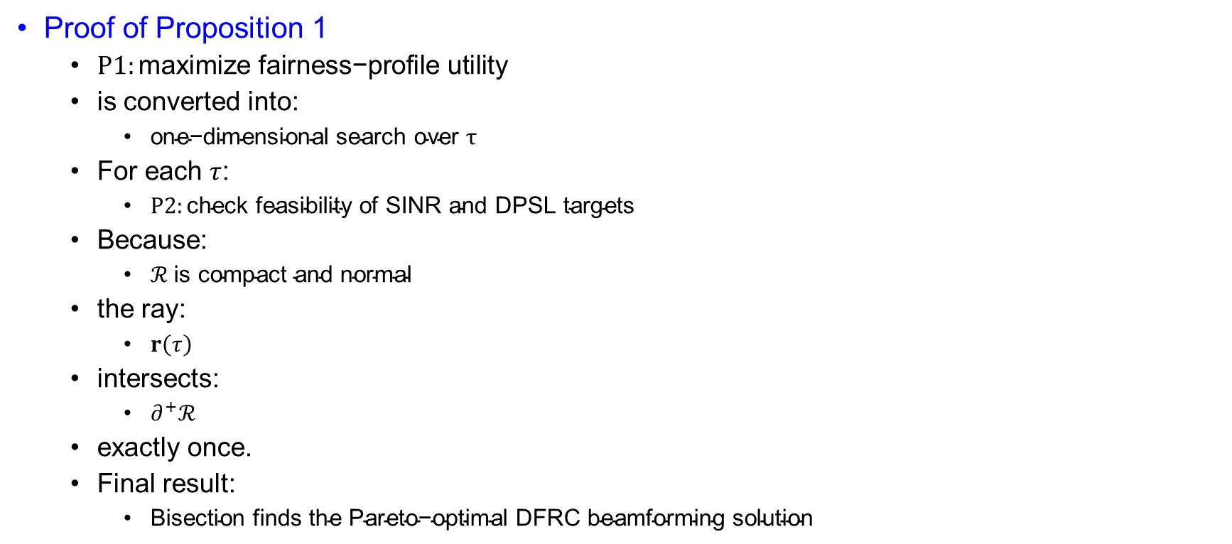
Joint Radar and Communication Optimization
Proof of Proposition 1
  $P1:\text{maximize} \text{fairness}\text{−}\text{profile} \text{utility}$
  is converted into:
    $\text{one}\text{−}\text{dimensional} \text{search} \text{over} τ$
  For each $τ$:
    $P2:\text{check} \text{feasibility} \text{of} \text{SINR} \text{and} \text{DPSL} \text{targets}$
  Because:
    $ℛ \text{is} \text{compact} \text{and} \text{normal}$
  the ray:
    $r\left(τ\right)$
  intersects:
    $∂^{+}ℛ$
  exactly once.
  Final result:
    $\text{Bisection} \text{finds} \text{the} \text{Pareto}\text{−}\text{optimal} \text{DFRC} \text{beamforming} \text{solution}$

Slide 43
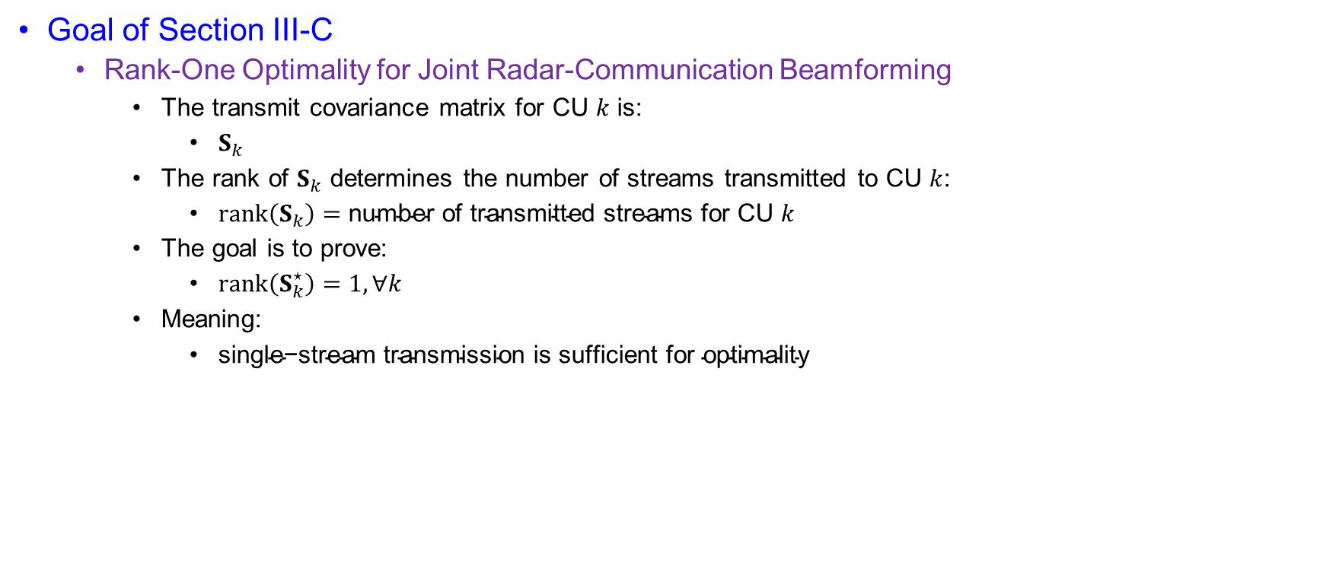
Optimality Achieved by Single-Stream Transmission
Goal of Section III-C
  Rank-One Optimality for Joint Radar-Communication Beamforming
    The transmit covariance matrix for CU $k$ is:
      $S_{k}$
    The rank of $S_{k}$ determines the number of streams transmitted to CU $k$:
      $rank⁡\left(S_{k}\right)=\text{number} \text{of} \text{transmitted} \text{streams} \text{for} \text{CU} k$
    The goal is to prove:
      $\operatorname{rank}\left(S_{k}^{⋆}\right)=1,∀k$
    Meaning:
      $\text{single}\text{−}\text{stream} \text{transmission} \text{is} \text{sufficient} \text{for} \text{optimality}$

Slide 44
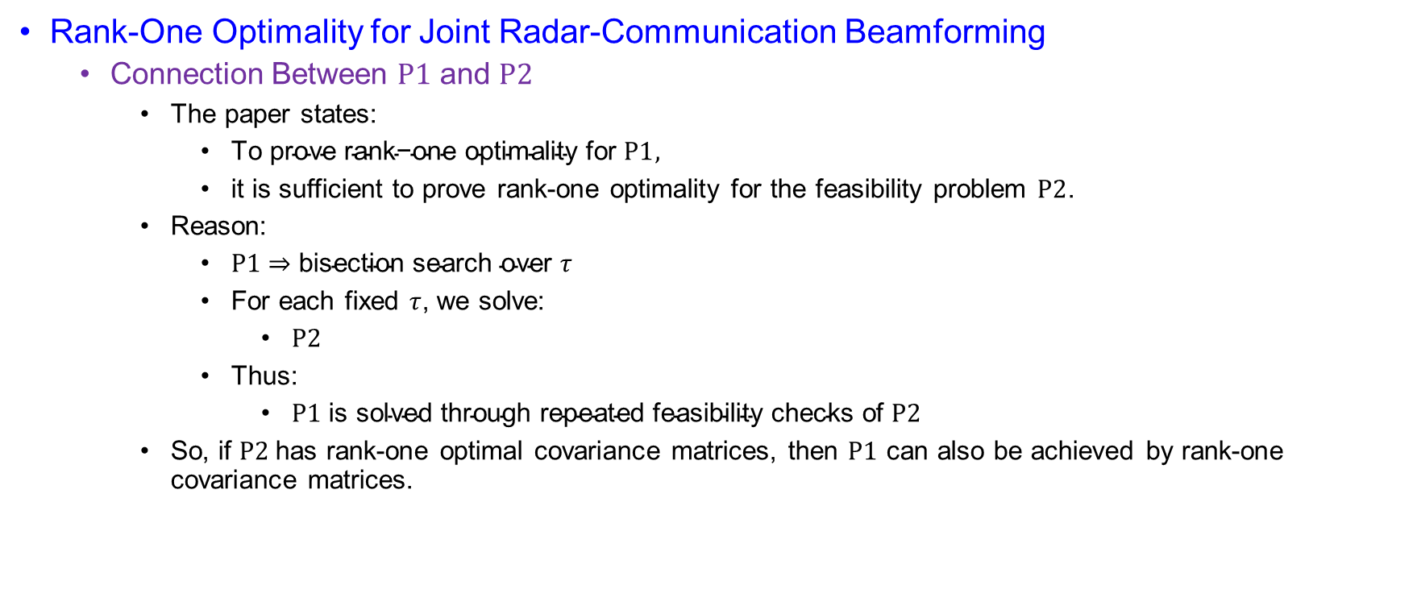
Optimality Achieved by Single-Stream Transmission
Rank-One Optimality for Joint Radar-Communication Beamforming
  Connection Between $P1$ and $P2$
    The paper states:
      $\text{To} \text{prove} \text{rank}\text{−}\text{one} \text{optimality} \text{for} P1,$
      it is sufficient to prove rank-one optimality for the feasibility problem $P2$.
    Reason:
      $P1⇒\text{bisection} \text{search} \text{over} τ$
      For each fixed $τ$, we solve:
        $P2$
      Thus:
        $P1 \text{is} \text{solved} \text{through} \text{repeated} \text{feasibility} \text{checks} \text{of} P2$
    So, if $P2$has rank-one optimal covariance matrices, then $P1$ can also be achieved by rank-one covariance matrices.

Slide 45

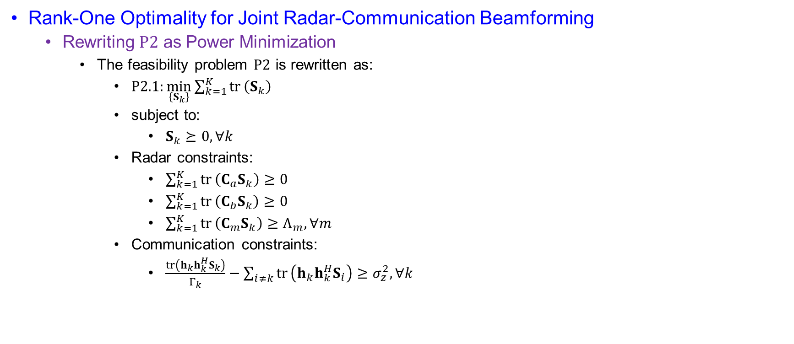
Optimality Achieved by Single-Stream Transmission
Rank-One Optimality for Joint Radar-Communication Beamforming
  Rewriting $P2$ as Power Minimization
    The feasibility problem $P2$ is rewritten as:
      $P2.1:\min_{\left\{S_{k}\right\}}\sum_{k=1}^{K}{tr}⁡\left(S_{k}\right)$
      subject to:
        $S_{k}⪰0, ∀k$
      Radar constraints:
        $\sum_{k=1}^{K}{tr}⁡\left(C_{a}S_{k}\right)≥0$
        $\sum_{k=1}^{K}{tr}⁡\left(C_{b}S_{k}\right)≥0$
        $\sum_{k=1}^{K}{tr}⁡\left(C_{m}S_{k}\right)≥Λ_{m}, ∀m$
      Communication constraints:
        $\frac{tr⁡\left(h_{k}h_{k}^{H}S_{k}\right)}{Γ_{k}}−\sum_{i≠k}{tr}⁡\left(h_{k}h_{k}^{H}S_{i}\right)≥σ_{z}^{2}, ∀k$
Matrices Used in $P2.1$
The paper defines:
    $$C_{a}=0.5a\left(θ_{0}\right)a^{H}\left(θ_{0}\right)−a\left(θ_{a}\right)a^{H}\left(θ_{a}\right)$$
    $$C_{b}=0.5a\left(θ_{0}\right)a^{H}\left(θ_{0}\right)−a\left(θ_{b}\right)a^{H}\left(θ_{b}\right)$$
    $$C_{m}=a\left(θ_{0}\right)a^{H}\left(θ_{0}\right)−a\left(θ_{m}\right)a^{H}\left(θ_{m}\right), ∀m$$
  These matrices transform the main-beam and DPSL constraints into trace forms.

Slide 46
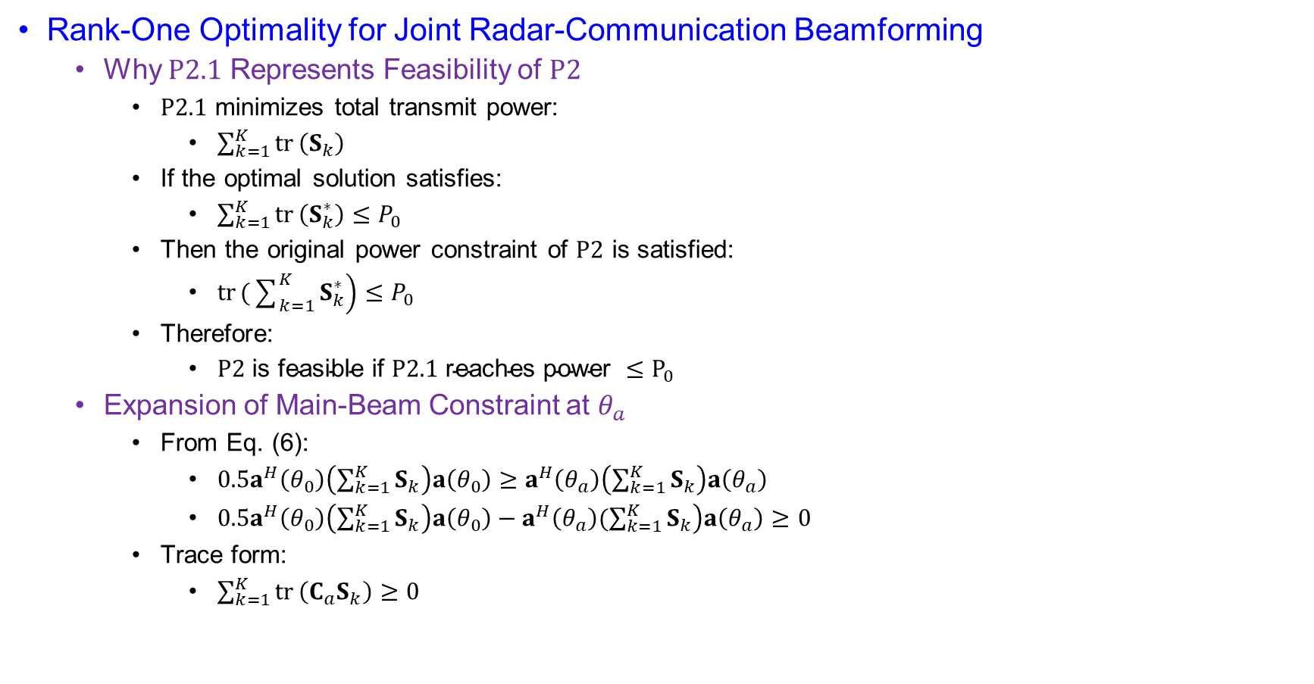
Optimality Achieved by Single-Stream Transmission
Rank-One Optimality for Joint Radar-Communication Beamforming
  Why $P2.1$ Represents Feasibility of $P2$
    $P2.1$ minimizes total transmit power:
      $\sum_{k=1}^{K}{tr}⁡\left(S_{k}\right)$
    If the optimal solution satisfies:
      $\sum_{k=1}^{K}{tr}⁡\left(S_{k}^{∗}\right)≤P_{0}$
    Then the original power constraint of $P2$ is satisfied:
      $\operatorname{tr}\left.(\sum_{k=1}^{K}{S_{k}^{∗}}\right)≤P_{0}$
    Therefore:
      $P2 \text{is} \text{feasible} \text{if} P2.1 \text{reaches} \text{power} ≤P_{0}$
  Expansion of Main-Beam Constraint at $θ_{a}$
    From Eq. (6):
      $0.5a^{H}\left(θ_{0}\right)\left(\sum_{k=1}^{K}{S_{k}}\right)a\left(θ_{0}\right)≥a^{H}\left(θ_{a}\right)\left(\sum_{k=1}^{K}{S_{k}}\right)a\left(θ_{a}\right)$
      $0.5a^{H}\left(θ_{0}\right)\left(\sum_{k=1}^{K}{S_{k}}\right)a\left(θ_{0}\right)−a^{H}\left(θ_{a}\right)\left.(\sum_{k=1}^{K}{S_{k}}\right)a\left(θ_{a}\right)≥0$
    Trace form:
      $\sum_{k=1}^{K}{tr}⁡\left(C_{a}S_{k}\right)≥0$

Slide 47
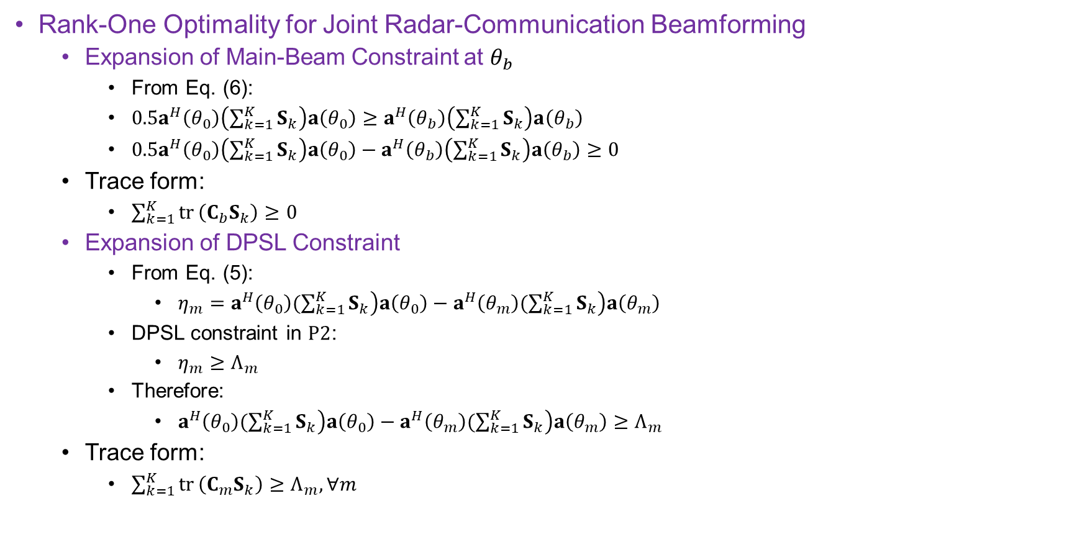
Optimality Achieved by Single-Stream Transmission
Rank-One Optimality for Joint Radar-Communication Beamforming
  Expansion of Main-Beam Constraint at $θ_{b}$
    From Eq. (6):
    $0.5a^{H}\left(θ_{0}\right)\left(\sum_{k=1}^{K}{S_{k}}\right)a\left(θ_{0}\right)≥a^{H}\left(θ_{b}\right)\left(\sum_{k=1}^{K}{S_{k}}\right)a\left(θ_{b}\right)$
    $0.5a^{H}\left(θ_{0}\right)\left(\sum_{k=1}^{K}{S_{k}}\right)a\left(θ_{0}\right)−a^{H}\left(θ_{b}\right)\left(\sum_{k=1}^{K}{S_{k}}\right)a\left(θ_{b}\right)≥0$
  Trace form:
    $\sum_{k=1}^{K}{tr}⁡\left(C_{b}S_{k}\right)≥0$
  Expansion of DPSL Constraint
    From Eq. (5):
      $η_{m}=a^{H}\left(θ_{0}\right)\left.(\sum_{k=1}^{K}{S_{k}}\right)a\left(θ_{0}\right)−a^{H}\left(θ_{m}\right)\left.(\sum_{k=1}^{K}{S_{k}}\right)a\left(θ_{m}\right)$
    DPSL constraint in $P2$:
      $η_{m}≥Λ_{m}$
    Therefore:
      $a^{H}\left(θ_{0}\right)\left.(\sum_{k=1}^{K}{S_{k}}\right)a\left(θ_{0}\right)−a^{H}\left(θ_{m}\right)\left.(\sum_{k=1}^{K}{S_{k}}\right)a\left(θ_{m}\right)≥Λ_{m}$
  Trace form:
    $\sum_{k=1}^{K}{tr}⁡\left(C_{m}S_{k}\right)≥Λ_{m}, ∀m$

Slide 48
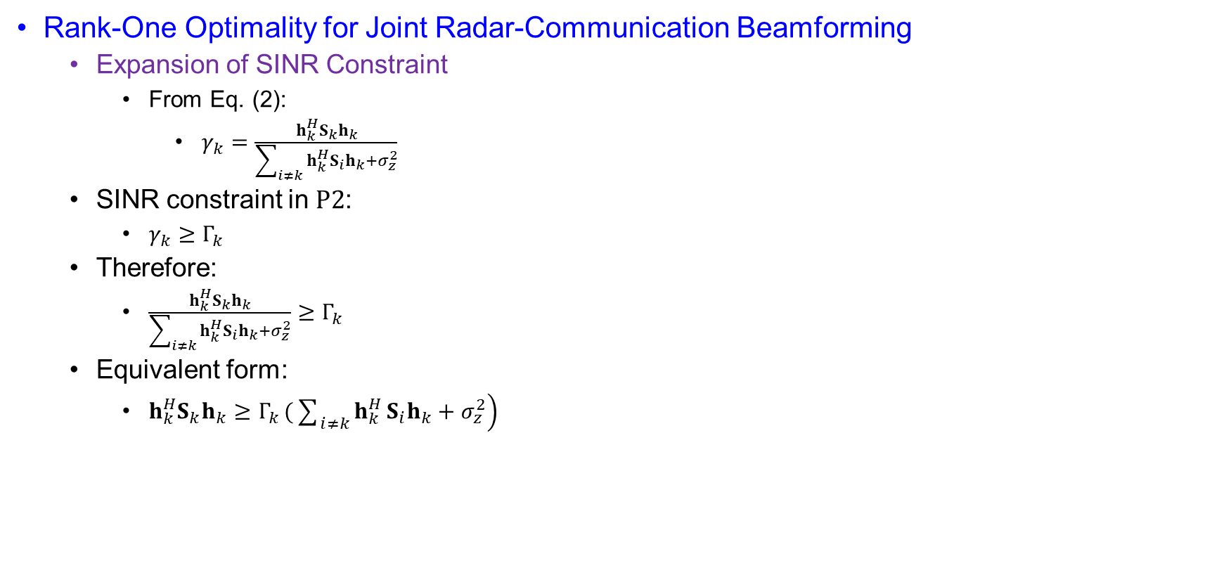
Optimality Achieved by Single-Stream Transmission
Rank-One Optimality for Joint Radar-Communication Beamforming
  Expansion of SINR Constraint
    From Eq. (2):
      $γ_{k}=\frac{h_{k}^{H}S_{k}h_{k}}{\sum_{i≠k}{h_{k}^{H}}S_{i}h_{k}+σ_{z}^{2}}$
  SINR constraint in $P2$:
    $γ_{k}≥Γ_{k}$
  Therefore:
    $\frac{h_{k}^{H}S_{k}h_{k}}{\sum_{i≠k}{h_{k}^{H}}S_{i}h_{k}+σ_{z}^{2}}≥Γ_{k}$
  Equivalent form:
    $h_{k}^{H}S_{k}h_{k}≥Γ_{k}\left.(\sum_{i≠k}{h_{k}^{H}}S_{i}h_{k}+σ_{z}^{2}\right)$

Slide 49
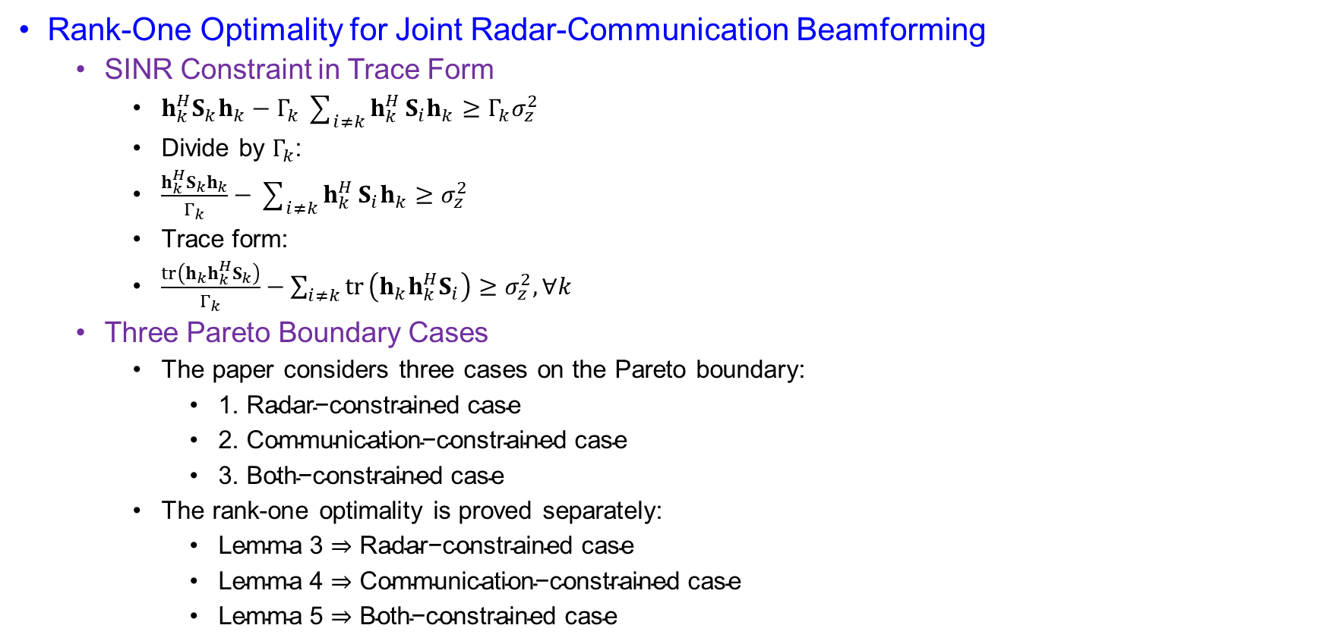
Optimality Achieved by Single-Stream Transmission
Rank-One Optimality for Joint Radar-Communication Beamforming
  SINR Constraint in Trace Form
    $h_{k}^{H}S_{k}h_{k}−Γ_{k}\sum_{i≠k}{h_{k}^{H}}S_{i}h_{k}≥Γ_{k}σ_{z}^{2}$
    Divide by $Γ_{k}$:
    $\frac{h_{k}^{H}S_{k}h_{k}}{Γ_{k}}−\sum_{i≠k}{h_{k}^{H}}S_{i}h_{k}≥σ_{z}^{2}$
    Trace form:
    $\frac{tr⁡\left(h_{k}h_{k}^{H}S_{k}\right)}{Γ_{k}}−\sum_{i≠k}{tr}⁡\left(h_{k}h_{k}^{H}S_{i}\right)≥σ_{z}^{2}, ∀k$
  Three Pareto Boundary Cases
    The paper considers three cases on the Pareto boundary:
      $\text{1}\text{.} \text{Radar}\text{−}\text{constrained} \text{case}$
      $\text{2}\text{.} \text{Communication}\text{−}\text{constrained} \text{case}$
      $\text{3}\text{.} \text{Both}\text{−}\text{constrained} \text{case}$
    The rank-one optimality is proved separately:
      $\text{Lemma} \text{3}⇒\text{Radar}\text{−}\text{constrained} \text{case}$
      $\text{Lemma} \text{4}⇒\text{Communication}\text{−}\text{constrained} \text{case}$
      $\text{Lemma} \text{5}⇒\text{Both}\text{−}\text{constrained} \text{case}$

Slide 50
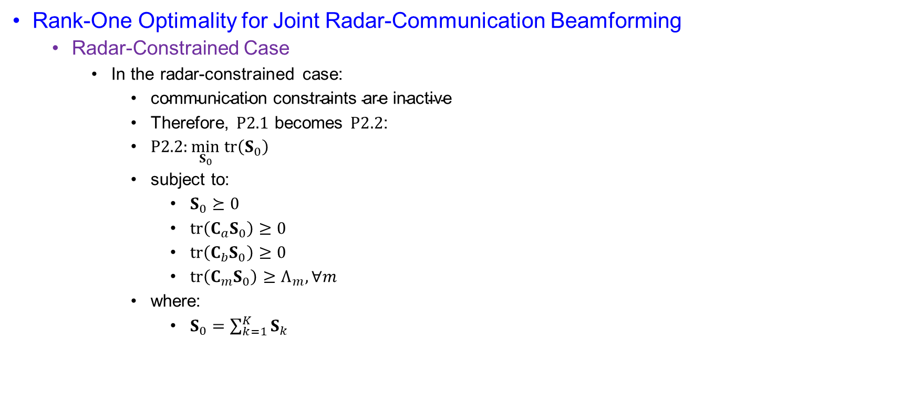
Optimality Achieved by Single-Stream Transmission
Rank-One Optimality for Joint Radar-Communication Beamforming
  Radar-Constrained Case
    In the radar-constrained case:
      $\text{communication} \text{constraints} \text{are} \text{inactive}$
      Therefore, $P2.1$ becomes $P2.2$:
      $P2.2:\min_{S_{0}} tr⁡\left(S_{0}\right)$
      subject to:
        $S_{0}⪰0$
        $tr⁡\left(C_{a}S_{0}\right)≥0$
        $tr⁡\left(C_{b}S_{0}\right)≥0$
        $tr⁡\left(C_{m}S_{0}\right)≥Λ_{m}, ∀m$
      where:
        $S_{0}=\sum_{k=1}^{K}{S_{k}}$

Slide 51
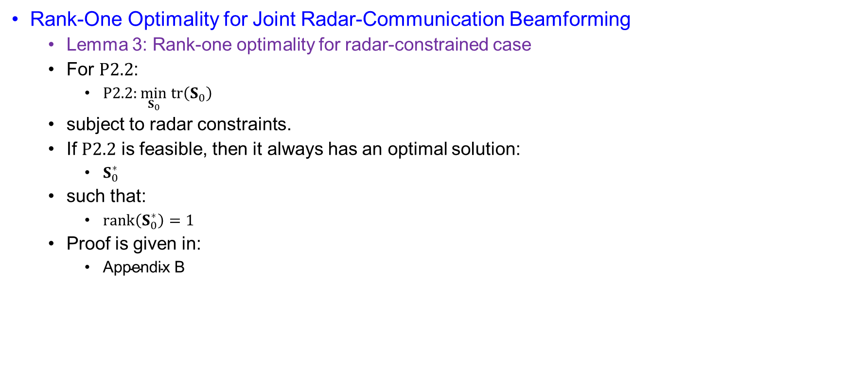
Optimality Achieved by Single-Stream Transmission
Rank-One Optimality for Joint Radar-Communication Beamforming
  Lemma 3: Rank-one optimality for radar-constrained case
  For $P2.2$:
    $P2.2:\min_{S_{0}} tr⁡\left(S_{0}\right)$
  subject to radar constraints.
  If $P2.2$ is feasible, then it always has an optimal solution:
    $S_{0}^{∗}$
  such that:
    $\operatorname{rank}\left(S_{0}^{∗}\right)=1$
  Proof is given in:
    $\text{Appendix} \text{B}$

Slide 52

Optimality Achieved by Single-Stream Transmission
Rank-One Optimality for Joint Radar-Communication Beamforming
  Appendix B: Lagrangian of $P2.2$
    The Lagrangian is:
      $L=−\sum_{m=1}^{M}{μ_{m}}Λ_{m}+tr⁡\left(ZS_{0}\right)+tr⁡\left(ΩS_{0}\right)$
    where:
      $Z⪰0$
    and:
      $Ω=μ_{a}C_{a}+μ_{b}C_{b}+\sum_{m=1}^{M}{μ_{m}}C_{m}−I$
    The dual variables are:
      $μ_{a}≥0, μ_{b}≥0, μ_{m}≥0, ∀m$
    Complementary Slackness
      At optimum:
        $tr⁡\left(ZS_{0}\right)=0$
      Since:
        $S_{0}≠0$
      the paper obtains:
        $rank⁡\left(Z\right)≤N−1$
      This gives the first rank condition:
        $rank⁡\left(Z\right)≤N−1$

Slide 53

Optimality Achieved by Single-Stream Transmission
Rank-One Optimality for Joint Radar-Communication Beamforming
  Stationarity
    Derivative of the Lagrangian at optimum:
      $\frac{∂L}{∂S_{0}}=Z+Ω=0$
    Thus:
      $Z=−Ω$
    Substitute $Ω$:
      $Z=I−\left(μ_{a}C_{a}+μ_{b}C_{b}+\sum_{m=1}^{M}{μ_{m}}C_{m}\right)$
    Then the paper writes:
      $Z=Ψ_{1}−Ψ_{2}$
  Expansion Using $C_{a},C_{b},C_{m}$
    From Eq. (18):
      $C_{a}=0.5a\left(θ_{0}\right)a^{H}\left(θ_{0}\right)−a\left(θ_{a}\right)a^{H}\left(θ_{a}\right)$
      $C_{b}=0.5a\left(θ_{0}\right)a^{H}\left(θ_{0}\right)−a\left(θ_{b}\right)a^{H}\left(θ_{b}\right)$
      $C_{m}=a\left(θ_{0}\right)a^{H}\left(θ_{0}\right)−a\left(θ_{m}\right)a^{H}\left(θ_{m}\right)$
    Therefore:
      $Ψ_{1}=μ_{a}a\left(θ_{a}\right)a^{H}\left(θ_{a}\right)+μ_{b}a\left(θ_{b}\right)a^{H}\left(θ_{b}\right)+\sum_{m=1}^{M}{μ_{m}}a\left(θ_{m}\right)a^{H}\left(θ_{m}\right)+I$
      $Ψ_{2}=\left(0.5μ_{a}+0.5μ_{b}+\sum_{m=1}^{M}{μ_{m}}\right)a\left(θ_{0}\right)a^{H}\left(θ_{0}\right)$

Slide 54

Optimality Achieved by Single-Stream Transmission
Rank-One Optimality for Joint Radar-Communication Beamforming
  Rank of $Ψ_{1}$and $Ψ_{2}$
    Since:
      $\sum_{m=1}^{M}{μ_{m}}a\left(θ_{m}\right)a^{H}\left(θ_{m}\right)⪰0$
      $μ_{a}a\left(θ_{a}\right)a^{H}\left(θ_{a}\right)⪰0$
      $μ_{b}a\left(θ_{b}\right)a^{H}\left(θ_{b}\right)⪰0$
    and $I$ is full-rank:
      $rank⁡\left(Ψ_{1}\right)=N$
    Also, not all dual variables can be zero. Therefore:
      $rank⁡\left(Ψ_{2}\right)=1$
  Final Rank Argument
    Since:
      $Z+Ψ_{2}=Ψ_{1}$
    the rank inequality gives:
      $rank⁡\left(Z\right)+rank⁡\left(Ψ_{2}\right)≥rank⁡\left(Ψ_{1}\right)$
    Using:
      $rank⁡\left(Ψ_{1}\right)=N$
      $rank⁡\left(Ψ_{2}\right)=1$

Slide 55

Optimality Achieved by Single-Stream Transmission
Rank-One Optimality for Joint Radar-Communication Beamforming
  Final Rank Argument
    we get:
      $rank⁡\left(Z\right)≥N−1$
    Together with:
      $rank⁡\left(Z\right)≤N−1$
    therefore:
      $rank⁡\left(Z\right)=N−1$
    Because:
      $tr⁡\left(ZS_{0}\right)=0$
    and:
      $S_{0}≠0$
    the optimal solution satisfies:
      $\operatorname{rank}\left(S_{0}\right)=1$

Slide 56

Optimality Achieved by Single-Stream Transmission
Rank-One Optimality for Joint Radar-Communication Beamforming
  Communication-Constrained Case
    In the communication-constrained case:
      $\text{radar} \text{constraints} \text{are} \text{inactive}$
      The problem becomes $P2.3$:
        $P2.3:\min_{\left\{S_{k}\right\}}\sum_{k=1}^{K}{tr}⁡\left(S_{k}\right)$
        subject to:
          $S_{k}⪰0, ∀k$
          $\sum_{k=1}^{K}{tr}⁡\left(C_{a}S_{k}\right)≥0$
          $\sum_{k=1}^{K}{tr}⁡\left(C_{b}S_{k}\right)≥0$
          $\frac{tr⁡\left(h_{k}h_{k}^{H}S_{k}\right)}{Γ_{k}}−\sum_{i≠k}{tr}⁡\left(h_{k}h_{k}^{H}S_{i}\right)≥σ_{z}^{2}, ∀k$
  Lemma 4: Rank-one optimality for communication-constrained case
    For $P2.3$, if it is feasible, then there always exists an optimal solution: $\left\{S_{k}^{⋆}\right\}$
    such that: $\operatorname{rank}\left(S_{k}^{∗}\right)=1$
  Proof is given in:
    Appendix C

Slide 57

Optimality Achieved by Single-Stream Transmission
Rank-One Optimality for Joint Radar-Communication Beamforming
  Lemma 4: Rank-one optimality for communication-constrained case
    Appendix C: Separable SDP Result
      Appendix C uses the result from $[37, Lemma 1]$.
      Consider the separable SDP:
        $\min_{\left\{X_{l}\right\}}\sum_{l=1}^{L}{tr}⁡\left(B_{l}X_{l}\right)$
      subject to:
        $\sum_{l=1}^{L}{tr}⁡\left(A_{ml}X_{l}\right)▹_{m}b_{m}, m=1,…,M$
        $X_{l}≻0, l=1,…,L$
        where:
        $▹_{m}∈\left\{≤ , ≥ , =\right\}, ∀m$
    Appendix C: Rank Bound
      If the separable SDP is feasible, it has an optimal solution:
        $\left\{X_{l}^{∗}\right\}$
      such that:
        $\sum_{l=1}^{L}{{\left[rank⁡\left(X_{l}^{∗}\right)\right]}^{2}}≤M$
      Applying this result to $P2.3$, the paper obtains:
        $\sum_{k=1}^{K}{{\left[rank⁡\left(S_{k}^{∗}\right)\right]}^{2}}≤K+2$

Slide 58

Optimality Achieved by Single-Stream Transmission
Rank-One Optimality for Joint Radar-Communication Beamforming
  Lemma 4: Rank-one optimality for communication-constrained case
    Appendix C: Final Rank-One Conclusion
      Due to the SINR constraint of each CU:
        $S_{k}^{∗}≠0, ∀k$
      Therefore:
        $rank⁡\left(S_{k}^{∗}\right)≥1, ∀k$
      Since:
        $\sum_{k=1}^{K}{{\left[rank⁡\left(S_{k}^{∗}\right)\right]}^{2}}≤K+2$
      and all $S_{k}^{∗}≠0$, the paper concludes:
        $rank⁡\left(S_{k}^{∗}\right)=1, ∀k$

Slide 59

Optimality Achieved by Single-Stream Transmission
Rank-One Optimality for Joint Radar-Communication Beamforming
  Both-Constrained Case
    In the both-constrained case:
      $\text{radar} \text{constraints} \text{and} \text{communication} \text{constraints} \text{are} \text{both} \text{active}$
      The paper proves rank-one optimality through Lemma 5.
    Lemma 5: Rank-one optimality for both-constrained case
      For $P2.1$, if it is feasible and both-constrained, then it always has an optimal solution:
        $\left\{S_{k}^{∗}\right\}$
      such that:
        $rank⁡\left(S_{k}^{∗}\right)=1, ∀k$
      Proof is given in:
        $\text{Appendix} \text{D}$

Slide 60

Optimality Achieved by Single-Stream Transmission
Rank-One Optimality for Joint Radar-Communication Beamforming
  Appendix D: Transmit Signal Decomposition
    Appendix D rewrites the transmit signal as:
      $x=\sum_{k=1}^{K}{s_{k}}+s_{0}$
    where:
      $s_{0}$ is the dedicated radar signal.
    The transmit strategy becomes:
    $\{S_{0}, S_{1}, …., S_{K}\}$
    where:
      $S_{0}=E\left(s_{0}s_{0}^{H}\right)$

Slide 61

Optimality Achieved by Single-Stream Transmission
Rank-One Optimality for Joint Radar-Communication Beamforming
  Appendix D: Reformulated Problem
  The problem becomes:
    $\min_{S_{0},\left\{S_{k}\right\}}\sum_{k=1}^{K}{tr}⁡\left(S_{k}\right)+tr⁡\left(S_{0}\right)$
  subject to:
    $S_{0}⪰0$
    $S_{k}⪰0, ∀k$
  Radar constraints:
    $\sum_{k=1}^{K}{tr}⁡\left(C_{a}S_{k}\right)+tr⁡\left(C_{a}S_{0}\right)≥0$
    $\sum_{k=1}^{K}{tr}⁡\left(C_{b}S_{k}\right)+tr⁡\left(C_{b}S_{0}\right)≥0$
    $\sum_{k=1}^{K}{tr}⁡\left(C_{m}S_{k}\right)+tr⁡\left(C_{m}S_{0}\right)≥Λ_{m}, ∀m$

Slide 62

Optimality Achieved by Single-Stream Transmission
Rank-One Optimality for Joint Radar-Communication Beamforming
  Appendix D: Communication Constraint With Dedicated Radar Signal
    The communication constraint becomes:
      $\frac{tr⁡\left(h_{k}h_{k}^{H}S_{k}\right)}{Γ_{k}}−\sum_{i≠k}{tr}⁡\left(h_{k}h_{k}^{H}S_{i}\right)−tr⁡\left(h_{k}h_{k}^{H}S_{0}\right)≥σ_{z}^{2}, ∀k$
      Important effect:
        $tr⁡\left(h_{k}h_{k}^{H}S_{0}\right)$
      appears as extra interference to CU $k$.
      The paper states:
        $S_{0}^{∗}=0$
      because the dedicated radar signal incurs additional interference to the CUs.

Slide 63

Optimality Achieved by Single-Stream Transmission
Rank-One Optimality for Joint Radar-Communication Beamforming
  Appendix D: Lagrangian
    The Lagrangian is:
      $L=−\sum_{k=1}^{K}{λ_{k}}σ_{z}^{2}−\sum_{m=1}^{M}{μ_{m}}Λ_{m}+\sum_{k=1}^{K}{tr}⁡\left(Φ_{k}S_{k}\right)+tr⁡\left(Φ_{0}S_{0}\right)$
    where:
      $Φ_{k}=Π+\frac{λ_{k}h_{k}h_{k}^{H}}{Γ_{k}}−\sum_{i≠k}{λ_{i}}h_{i}h_{i}^{H}−I+Z_{k}$
      $Φ_{0}=Π−\sum_{i=1}^{K}{λ_{i}}h_{i}h_{i}^{H}−I+Z_{0}$
      $Π=μ_{a}C_{a}+μ_{b}C_{b}+\sum_{m=1}^{M}{μ_{m}}C_{m}$
  Appendix D: Complementary Slackness
    At optimum:
      $tr⁡\left(Z_{0}S_{0}\right)=0$
      And $tr⁡\left(Z_{k}S_{k}\right)=0, ∀k$
    Since:
      $S_{0}^{⋆}=0$
    the paper obtains:
      $rank⁡\left(Z_{0}\right)=N$
    Also, because:
      $S_{k}^{∗}≠0, ∀k$
      one has: $rank⁡\left(Z_{k}\right)≤N−1, ∀k$

Slide 64

Optimality Achieved by Single-Stream Transmission
Rank-One Optimality for Joint Radar-Communication Beamforming
  Appendix D: Stationarity Conditions
    The derivative of the Lagrangian at the optimum gives:
      $\frac{∂L}{∂S_{0}}=0$
    and
      $\frac{∂L}{∂S_{k}}=0, ∀k$
    Thus:
      $Z_{0}=I+\sum_{i=1}^{K}{λ_{i}}h_{i}h_{i}^{H}−Π$
    and
      $Z_{k}=I+\sum_{i=1}^{K}{λ_{i}}h_{i}h_{i}^{H}−Π−\left(1+\frac{λ_{k}}{Γ_{k}}\right)h_{k}h_{k}^{H}, ∀k$
    Therefore:
      $Z_{k}=Z_{0}−\left(1+\frac{λ_{k}}{Γ_{k}}\right)h_{k}h_{k}^{H}, ∀k$

Slide 65

Optimality Achieved by Single-Stream Transmission
Rank-One Optimality for Joint Radar-Communication Beamforming
  Appendix D: Rank Argument
    From:
      $Z_{k}=Z_{0}−\left(1+\frac{λ_{k}}{Γ_{k}}\right)h_{k}h_{k}^{H}$
    the paper obtains:
      $rank⁡\left(Z_{k}\right)+\operatorname{rank}\left(\left(1+\frac{λ_{k}}{Γ_{k}}\right)h_{k}h_{k}^{H}\right)≥rank⁡\left(Z_{0}\right)$
    Since:
      $rank⁡\left(Z_{0}\right)=N$
    and:
      $\operatorname{rank}\left(\left(1+\frac{λ_{k}}{Γ_{k}}\right)h_{k}h_{k}^{H}\right)=1$
    then:
      $rank⁡\left(Z_{k}\right)≥N−1, ∀k$
    Together with:
      $rank⁡\left(Z_{k}\right)≤N−1, ∀k$
    we obtain:
      $rank⁡\left(Z_{k}\right)=N−1, ∀k$

Slide 66

Optimality Achieved by Single-Stream Transmission
Rank-One Optimality for Joint Radar-Communication Beamforming
  Appendix D: Final Rank-One Result
    Since:
      $tr⁡\left(Z_{k}S_{k}\right)=0, ∀k$
      and:
      $S_{k}^{∗}≠0, ∀k$
    with:
      $rank⁡\left(Z_{k}\right)=N−1, ∀k$
    the optimal covariance matrices satisfy:
      $rank⁡\left(S_{k}^{∗}\right)=1, ∀k$
    This proves Lemma 5.

Slide 67

Optimality Achieved by Single-Stream Transmission
Rank-One Optimality for Joint Radar-Communication Beamforming
  Proposition 2: Optimality achieved by single-stream transmission
    For $P1$, if the problem is feasible, then there exists an optimal solution:
      $\left\{S_{k}^{∗}\right\}$
    such that:
      $rank⁡\left(S_{k}^{∗}\right)=1, ∀k$
    Therefore:
      $\text{It} \text{is} \text{sufficient} \text{to} \text{consider} \text{rank}\text{−}\text{one} \text{signal} \text{covariance} \text{matrices}$
  Proof of Proposition 2
    The proof follows directly from three cases:
      $\text{Radar}\text{−}\text{constrained} \text{case}⇒\text{Lemma} \text{3}⇒rank⁡\left(S_{0}^{∗}\right)=1$
      $\text{Communication}\text{−}\text{constrained} \text{case}⇒\text{Lemma} \text{4}⇒rank⁡\left(S_{k}^{∗}\right)=1, ∀k$
      $\text{Both}\text{−}\text{constrained} \text{case}⇒\text{Lemma} \text{5}⇒rank⁡\left(S_{k}^{∗}\right)=1, ∀k$
    Therefore:
      $P1 \text{can} \text{achieve} \text{optimality} \text{with} \text{single}\text{−}\text{stream} \text{transmission}$

Slide 68

Optimality Achieved by Single-Stream Transmission
Rank-One Optimality for Joint Radar-Communication Beamforming
  Final Conceptual Summary
    The paper proves:
      $rank⁡\left(S_{k}^{∗}\right)=1, ∀k$
    This means:
      $S_{k}^{∗}$ does not need to be high-rank.
      Each CU can be served using one stream.
    Final message:
      $\text{The} \text{Pareto}\text{−}\text{optimal} \text{DFRC} \text{solution} \text{can} \text{be} \text{achieved} \text{by} \text{single}\text{−}\text{stream} \text{beamforming}$

Slide 69

Hardware-Impared Optimization
Impairment-Aware SINR, DPSL, and Fairness-Profile Reformulation
  Ideal transmitter model:
    $x=\sum_{k=1}^{K}{s_{k}}$
  Hardware-impaired transmitter model:
    $x=\sum_{k=1}^{K}{s_{k}}+z^{\left(t\right)}$
  where
    $z^{\left(t\right)}∼𝒞𝒩(0,C^{t})$
  Communication Signal With Impairment
    $y_{k}=h_{k}^{H}\left.(\sum_{k=1}^{K}{s_{k}}+z^{\left(t\right)}\right)+z_{k}$
  Expand:
    $y_{k}=\underset{\text{desired} \text{signal}}{\underbrace{h_{k}^{H}s_{k}}}+\underset{\text{multi}\text{−}\text{user} \text{interference}}{\underbrace{\sum_{i≠k}{h_{k}^{H}}s_{i}}}+\underset{\text{hardware} \text{distortion}}{\underbrace{h_{k}^{H}z^{\left(t\right)}}}+\underset{\text{AWGN}}{\underbrace{z_{k}}}$

Slide 70

Hardware-Impared Optimization
Impairment-Aware SINR, DPSL, and Fairness-Profile Reformulation
  Distortion Covariance
    $C^{\left(t\right)}=diag\left\{c_{1}^{2},…., c_{N}^{2}\right\}$
    For antenna $n$:
      $c_{n}=ψ\left(\sqrt{\operatorname{tr}\left(Λ_{n}\sum_{k=1}^{K}{S_{k}}\right)}\right)$
    Where,
      $Λ_{n}=diag(0,…,1,…,0)$
  Meaning of Antenna-Wise Distortion
    Antenna-$n$ transmit power:
      $\operatorname{tr}\left(Λ_{n}\sum_{k=1}^{K}{S_{k}}\right)$
    Transmit magnitude:
      $\sqrt{\operatorname{tr}\left(Λ_{n}\sum_{k=1}^{K}{S_{k}}\right)}$
    Distortion magnitude:
      $c_{n}=ψ\left(\text{transmit} \text{magnitude} \text{at} \text{antenna} n\right)$

Slide 71

Hardware-Impared Optimization
Impairment-Aware SINR, DPSL, and Fairness-Profile Reformulation
  Distortion Function
    $ψ\left(⋅\right)$ is monotonically increasing.
    Linear model:
      $ψ\left(x\right)=κx$
    Convex nonlinear model:
      $ψ\left(x\right)=\text{convex} \text{polynomial} \text{with} \text{positive} \text{coefficients}$
    Core idea:
      $\text{larger} \text{transmit} \text{magnitude}⇒\text{larger} \text{distortion} \text{magnitude}$
  SINR With Hardware Impairment
    Ideal SINR:
      $γ_{k}=\frac{h_{k}^{H}S_{k}h_{k}}{\sum_{i≠k}{h_{k}^{H}}S_{i}h_{k}+σ_{z}^{2}}$
    Impaired SINR:
      $γ_{k}^{′}=\frac{h_{k}^{H}S_{k}h_{k}}{\sum_{i≠k}{h_{k}^{H}}S_{i}h_{k}+h_{k}^{H}C^{\left(t\right)}h_{k}+σ_{z}^{2}}$

Slide 72

Hardware-Impared Optimization
Impairment-Aware SINR, DPSL, and Fairness-Profile Reformulation
  Effect on Communication
    New distortion-interference term:
      $h_{k}^{H}C^{\left(t\right)}h_{k}$
    Thus:
      $\text{denominator} \text{increases}$
      $⇒γ_{k}^{′}≤γ_{k}$
    Hardware impairment reduces communication SINR.
  Power Constraint With Impairment
    Ideal power constraint:
      $\operatorname{tr}\left.(\sum_{k=1}^{K}{S_{k}}\right)≤P_{0}$
    Impaired power constraint:
      $\operatorname{tr}\left.(\sum_{k=1}^{K}{S_{k}}+C^{\left(t\right)}\right)≤P_{0}$
    Expand:
      $\operatorname{tr}\left.(\sum_{k=1}^{K}{S_{k}}\right)+\operatorname{tr}\left(C^{\left(t\right)}\right)≤P_{0}$

Slide 73

Hardware-Impared Optimization
Impairment-Aware SINR, DPSL, and Fairness-Profile Reformulation
  Radar Probing Power With Impairment
    Ideal probing power:
      $P_{\text{pro}}\left(θ\right)=a^{H}\left(θ\right)\left.(\sum_{k=1}^{K}{S_{k}}\right)a\left(θ\right)$
    Impaired probing power:
      $P_{\text{pro}}\left(θ\right)=a^{H}\left(θ\right)\left.(\sum_{k=1}^{K}{S_{k}}+C^{\left(t\right)}\right)a\left(θ\right)$
    Expand:
      $P_{\text{pro}}\left(θ\right)=a^{H}\left(θ\right)\left.(\sum_{k=1}^{K}{S_{k}}\right)a\left(θ\right)+a^{H}\left(θ\right)C^{\left(t\right)}a\left(θ\right)$
  DPSL With Impairment
    Ideal DPSL:
      $η_{m}=a^{H}\left(θ_{0}\right)\left.(\sum_{k=1}^{K}{S_{k}}\right)a\left(θ_{0}\right)−a^{H}\left(θ_{m}\right)\left.(\sum_{k=1}^{K}{S_{k}}\right)a\left(θ_{m}\right)$
    Impaired DPSL:
      $η_{m}^{′}=a^{H}\left(θ_{0}\right)\left.(\sum_{k=1}^{K}{S_{k}}+C^{\left(t\right)}\right)a\left(θ_{0}\right)−a^{H}\left(θ_{m}\right)\left.(\sum_{k=1}^{K}{S_{k}}+C^{\left(t\right)}\right)a\left(θ_{m}\right)$

Slide 74

Hardware-Impared Optimization
Impairment-Aware SINR, DPSL, and Fairness-Profile Reformulation
  Expanded DPSL With Impairment
    $η_{m}^{′}=a^{H}\left(θ_{0}\right)\left.(\sum_{k=1}^{K}{S_{k}}\right)a\left(θ_{0}\right)−a^{H}\left(θ_{m}\right)\left.(\sum_{k=1}^{K}{S_{k}}\right)a\left(θ_{m}\right)+a^{H}\left(θ_{0}\right)C^{\left(t\right)}a\left(θ_{0}\right)−a^{H}\left(θ_{m}\right)C^{\left(t\right)}a\left(θ_{m}\right)$
  So:
    $η_{m}^{′}=η_{m}+a^{H}\left(θ_{0}\right)C^{\left(t\right)}a\left(θ_{0}\right)−a^{H}\left(θ_{m}\right)C^{\left(t\right)}a\left(θ_{m}\right)$
  Main-Beam Constraint With Impairment
    $0.5a^{H}\left(θ_{0}\right)\left.(\sum_{k=1}^{K}{S_{k}}+C^{\left(t\right)}\right)a\left(θ_{0}\right)≥a^{H}\left(θ_{a}\right)\left.(\sum_{k=1}^{K}{S_{k}}+C^{\left(t\right)}\right)a\left(θ_{a}\right)$
    $0.5a^{H}\left(θ_{0}\right)\left.(\sum_{k=1}^{K}{S_{k}}+C^{\left(t\right)}\right)a\left(θ_{0}\right)≥a^{H}\left(θ_{b}\right)\left.(\sum_{k=1}^{K}{S_{k}}+C^{\left(t\right)}\right)a\left(θ_{b}\right)$
  Impairment-Aware Utility Problem $P3$
  $P3:\max_{\left\{S_{k}\right\}}\min_{k,m}\left\{\frac{γ_{k}^{′}−a_{k}}{α_{k}} , \frac{η_{m}^{′}−b_{m}}{β_{m}}\right\}$
  subject to:
    $\operatorname{tr}\left.(\sum_{k=1}^{K}{S_{k}}+C^{\left(t\right)}\right)≤P_{0}$
  and impaired main-beam constraints.

Slide 75

Hardware-Impared Optimization
Impairment-Aware SINR, DPSL, and Fairness-Profile Reformulation
  Fixed Targets for Bisection
    Using the same ray-search idea:
      $Γ_{k}\left(τ\right)=α_{k}τ+a_{k}$
      $Λ_{m}\left(τ\right)=β_{m}τ+b_{m}$
    For a fixed $τ$:
      $γ_{k}^{′}≥Γ_{k}\left(τ\right)$
      $η_{m}^{′}≥Λ_{m}\left(τ\right)$
  Feasibility Problem $P3.1$
    $P3.1 :find \{S_{1},….,S_{k}\}$
  subject to:
    $\operatorname{tr}\left.(\sum_{k=1}^{K}{S_{k}}+C^{\left(t\right)}\right)≤P_{0}$
    $η_{m}^{′}≥Λ_{m}, ∀m$
    $γ_{k}^{′}≥Γ_{k}, ∀k$
  and impaired main-beam constraints.

Slide 76

Hardware-Impared Optimization
Impairment-Aware SINR, DPSL, and Fairness-Profile Reformulation
  Expanded SINR Constraint in $P3.1$
    $γ_{k}^{′}≥Γ_{k}$
    $\frac{h_{k}^{H}S_{k}h_{k}}{\sum_{i≠k}{h_{k}^{H}}S_{i}h_{k}+h_{k}^{H}C^{\left(t\right)}h_{k}+σ_{z}^{2}}≥Γ_{k}$
    Equivalent:
    $h_{k}^{H}S_{k}h_{k}≥Γ_{k}\left.(\sum_{i≠k}{h_{k}^{H}}S_{i}h_{k}+h_{k}^{H}C^{\left(t\right)}h_{k}+σ_{z}^{2}\right)$
  Expanded DPSL Constraint in $P3.1$
    $η_{m}^{′}≥Λ_{m}$
    $a^{H}\left(θ_{0}\right)\left.(\sum_{k=1}^{K}{S_{k}}+C^{\left(t\right)}\right)a\left(θ_{0}\right)−a^{H}\left(θ_{m}\right)\left.(\sum_{k=1}^{K}{S_{k}}+C^{\left(t\right)}\right)a\left(θ_{m}\right)≥Λ_{m}$
  Main Difficulty
    $C^{\left(t\right)}=diag⁡\left\{c_{1}^{2} , … , c_{N}^{2}\right\}$
    And $c_{n}=ψ\left(\sqrt{\operatorname{tr}\left(Λ_{n}\sum_{k=1}^{K}{S_{k}}\right)}\right)$
  Therefore:
    $C^{\left(t\right)}$ depends on: $\left\{S_{1},….,S_{k}\right\}$
    So $P3.1$ is harder than ideal $P2$.

Slide 77

Hardware-Impared Optimization
Impairment-Aware SINR, DPSL, and Fairness-Profile Reformulation
  Proposition 3: Convex Reformulation
  If $ψ\left(⋅\right)$ is monotonic increasing and convex, then $P3.1$can be reformulated as a convex problem.
  Introduce:
    $d_{1},…,d_{N}$ and $D=\operatorname{diag}\left\{d_{1},…,d_{N}\right\}$
  Then replace:
    $C^{\left(t\right)}$ with $D$
  Auxiliary Distortion Constraint
    For each antenna $n$:
      $ψ\left(\sqrt{\operatorname{tr}\left(Λ_{n}\sum_{k=1}^{K}{S_{k}}\right)}\right)≤d_{n}$
    This means:
      $d_{n}$ is upper-bounds the distortion magnitude at antenna $n$.

Slide 78

Hardware-Impared Optimization
Impairment-Aware SINR, DPSL, and Fairness-Profile Reformulation
  Convex Problem $P3.2$
    $P3.2 :find \left\{S_{1},….,S_{k}, d_{1},….,d_{N}\right\}$
    subject to:
      $\operatorname{tr}\left.(\sum_{k=1}^{K}{S_{k}}+D\right)≤P_{0}$
      $η_{m}^{′}\left(D\right)≥Λ_{m}, ∀m$
      $γ_{k}^{′}\left(D\right)≥Γ_{k}, ∀k$
      $ψ\left(\sqrt{\operatorname{tr}\left(Λ_{n}\sum_{k=1}^{K}{S_{k}}\right)}\right)≤d_{n}, ∀n$
  Expanded $P3.2$ SINR Constraint
    $\frac{h_{k}^{H}S_{k}h_{k}}{\sum_{i≠k}{h_{k}^{H}}S_{i}h_{k}+h_{k}^{H}Dh_{k}+σ_{z}^{2}}≥Γ_{k}$
  Equivalent:
    $h_{k}^{H}S_{k}h_{k}−Γ_{k}\sum_{i≠k}{h_{k}^{H}}S_{i}h_{k}−Γ_{k}h_{k}^{H}Dh_{k}≥Γ_{k}σ_{z}^{2}$

Slide 79

Hardware-Impared Optimization
Impairment-Aware SINR, DPSL, and Fairness-Profile Reformulation
  Expanded $P3.2$ DPSL Constraint
    $a^{H}\left(θ_{0}\right)\left.(\sum_{k=1}^{K}{S_{k}}+D\right)a\left(θ_{0}\right)−a^{H}\left(θ_{m}\right)\left.(\sum_{k=1}^{K}{S_{k}}+D\right)a\left(θ_{m}\right)≥Λ_{m}$
  Expand:
    $a^{H}\left(θ_{0}\right)\left.(\sum_{k=1}^{K}{S_{k}}\right)a\left(θ_{0}\right)−a^{H}\left(θ_{m}\right)\left.(\sum_{k=1}^{K}{S_{k}}\right)a\left(θ_{m}\right)+a^{H}\left(θ_{0}\right)Da\left(θ_{0}\right)−a^{H}\left(θ_{m}\right)Da\left(θ_{m}\right)≥Λ_{m}$
  Why $P3.2$ is Convex
    If $ψ\left(⋅\right)$ is monotonic increasing and convex, then:
      $ψ\left(\sqrt{\operatorname{tr}\left(Λ_{n}\sum_{k=1}^{K}{S_{k}}\right)}\right)≤d_{n}$ is convex.
    Also:
      $P3.2$ is a convex QCQP and can be reduced to SDP.

Slide 80

Hardware-Impared Optimization
Complexity
  The problem $P3.2$ has polynomial complexity in:
  $N$
  $K$
  $K+M$
  and the bisection iteration number:
    $\left[\log_{2}\left(\frac{τ_{max}}{Δ}\right) \right]$
  Thus:
    $P3$
    can be solved with polynomial worst-case complexity.

Slide 81

Hardware-Impared Optimization
Final Summary
  Ideal case:
    $\sum_{k=1}^{K}{S_{k}}$
  Hardware-impaired case:
    $\sum_{k=1}^{K}{S_{k}}+C^{\left(t\right)}$
  Main changes:
    $γ_{k}→γ_{k}^{′}$
    $η_{m}→η_{m}^{′}$
    $P1→P3$
    $P2→P3.1→P3.2$
  Final message:
    $\text{The} \text{DFRC} \text{Pareto} \text{optimization} \text{framework} \text{is} \text{extended} \text{to} \text{practical} \text{hardware}\text{−}\text{impaired} \text{transmitters}$

Slide 82

Reproduction
Similarity-Based Benchmark Schemes for DFRC Beamforming
Covariance Similarity [21] vs. Waveform Similarity [22]
Why Benchmark Schemes Are Needed
  Benchmark Motivation
  The proposed Pareto method directly maximizes the radar DPSL:
  $\max_{\left\{S_{k}\right\}}\underset{m}{\min{ }}η_{m}$
  where
    $η_{m}=a^{H}\left(θ_{0}\right)\left.(\sum_{k=1}^{K}{S_{k}}\right)a\left(θ_{0}\right)−a^{H}\left(θ_{m}\right)\left.(\sum_{k=1}^{K}{S_{k}}\right)a\left(θ_{m}\right)$
  To compare with existing DFRC designs, we use similarity-based schemes:
    $\text{Keep} \text{the} \text{joint} \text{communication}\text{−}\text{radar} \text{signal} \text{close} \text{to} \text{a} \text{radar}\text{−}\text{only} \text{reference}$
    The radar-only covariance is obtained first:
      $S_{0}^{⋆}=\arg{\max_{S_{0}}}\min_{m}\operatorname{tr}\left(C_{m}S_{0}\right)$
      where
        $C_{m}=a\left(θ_{0}\right)a^{H}\left(θ_{0}\right)−a\left(θ_{m}\right)a^{H}\left(θ_{m}\right)$

Slide 83

Reproduction
Paper [21]: Covariance-Similarity Scheme
Paper [21] Benchmark: Covariance Matching
  Paper [21] designs communication covariance matrices:
    $\left\{S_{1} , S_{2} , … , S_{K}\right\}$
  The total joint transmit covariance is
    $S_{sum}=\sum_{k=1}^{K}{S_{k}}$
  The goal is to keep this joint covariance close to the radar-only covariance:
    $\min_{\left\{S_{k}\right\}}{∥\sum_{k=1}^{K}{S_{k}}−S_{0}^{⋆}∥}_{F}^{2}$
  subject to
    $S_{k}⪰0, ∀k$
    $\operatorname{diag}\left.(\sum_{k=1}^{K}{S_{k}}\right)=\frac{P_{0}}{N}1$
    and communication SINR constraints:
    $γ_{k}≥Γ_{k}, ∀k$

Slide 84

Reproduction
Expanding the SINR Constraint in Paper [21]
SINR Constraint for Covariance-Similarity Scheme
  For CU $k$, the received SINR is
    $γ_{k}=\frac{h_{k}^{H}S_{k}h_{k}}{\sum_{i≠k}{h_{k}^{H}}S_{i}h_{k}+σ_{z}^{2}}$
  The constraint is
    $γ_{k}≥Γ_{k}$
  Substitute the SINR expression:
    $\frac{h_{k}^{H}S_{k}h_{k}}{\sum_{i≠k}{h_{k}^{H}}S_{i}h_{k}+σ_{z}^{2}}≥Γ_{k}$
  Equivalent linear form:
    $h_{k}^{H}S_{k}h_{k}≥Γ_{k}\left.(\sum_{i≠k}{h_{k}^{H}}S_{i}h_{k}+σ_{z}^{2}\right)$
    or
    $\boxed{\frac{h_{k}^{H}S_{k}h_{k}}{Γ_{k}}−\sum_{i≠k}{h_{k}^{H}}S_{i}h_{k}≥σ_{z}^{2}}$
This is why the covariance-similarity benchmark can be solved by convex optimization.

Slide 85

Reproduction
Paper [21] Radar Performance Evaluation
DPSL Evaluation After Solving Paper [21]
  After obtaining ${\left\{S_{k}^{⋆}\right\}}_{k=1}^{K}$
  the joint covariance is $S_{sum}^{⋆}=\sum_{k=1}^{K}{S_{k}^{⋆}}$
  The radar probing power at angle $θ$ is
    $P_{pro}\left(θ\right)=a^{H}\left(θ\right)S_{sum}^{⋆}a\left(θ\right)$
  The DPSL at sidelobe angle $θ_{m}$is
    $η_{m}=P_{pro}\left(θ_{0}\right)−P_{pro}\left(θ_{m}\right)$
  Expanded:
    $η_{m}=a^{H}\left(θ_{0}\right)S_{sum}^{⋆}a\left(θ_{0}\right)−a^{H}\left(θ_{m}\right)S_{sum}^{⋆}a\left(θ_{m}\right)$
  Final plotted metric:
    $η_{min}=\min_{ m}{ η}_{m}$
  and in dB scale:
    $η_{dB}=10\log_{10}\left(\frac{η_{min}}{P_{0}}\right)$

Slide 86

Reproduction
Paper [22]: Waveform-Similarity Scheme
  Paper [22] Benchmark: Waveform Matching
  Paper [22] designs the transmit waveform matrix:
    $X∈ℂ^{N×L}$
  where
    $N=\text{number} \text{of} \text{transmit} \text{antennas}$
    $L=\text{number} \text{of} \text{waveform} \text{snapshots}$
  The received communication signal is
    $Y=HX+W$
  The desired symbol matrix is
    $S∈ℂ^{K×L}$
  The multi-user interference is
    $HX−S$
  and the MUI energy is
    $∥HX−S∥_{F}^{2}$

Slide 87

Reproduction
Paper [22] Waveform Similarity Objective
Weighted Communication-Radar Waveform Design
Paper [22] uses a weighted objective:
  $\min_{X} ρ∥HX−S∥_{F}^{2}+\left(1−ρ\right)∥X−X_{0}∥_{F}^{2}$
  subject to the power constraint:
    $∥X∥_{F}^{2}=LP_{0}$
    Here,
    $ρ$ $⇒$ controls the communication-radar tradeoff.
    If $ρ→1$ then the design emphasizes communication MUI minimization: $∥HX−S∥_{F}^{2}$
    If $ρ→0$ then the design emphasizes radar waveform similarity:
      $∥X−X_{0}∥_{F}^{2}$
    For our comparison, we use a balanced radar-dominant value:
      $ρ=0.05 \text{or} 0.1$
      depending on stability.

Slide 88

Reproduction
Constructing the Radar Reference Waveform $X_{0}$
From Radar-Only Covariance to Reference Waveform
  Radar-only covariance: $S_{0}^{⋆}$
  We need a waveform $X_{0}$ such that
    $\frac{1}{L}X_{0}X_{0}^{H}=S_{0}^{⋆}$
  Use eigenvalue decomposition:
    $S_{0}^{⋆}=UΛU^{H}$
  Then
    ${\left(S_{0}^{⋆}\right)}^{1/2}=UΛ^{1/2}U^{H}$
  Construct
    $X_{0}=\sqrt{L}{\left(S_{0}^{⋆}\right)}^{1/2}Q$
  where
    $QQ^{H}=I_{N}$
  Then
    $\frac{1}{L}X_{0}X_{0}^{H}=S_{0}^{⋆}$
  This ensures that $X_{0}$has the same radar covariance as the radar-only solution.

Slide 89

Reproduction
Solving Paper [22] Waveform Problem
  Compact Least-Squares Form
  The objective is
    $ρ∥HX−S∥_{F}^{2}+\left(1−ρ\right)∥X−X_{0}∥_{F}^{2}$
  This can be rewritten as
    $\min_{X}∥AX−B∥_{F}^{2}$
  where
    $A=\left[\begin{matrix}\sqrt{ρ}H \\ \sqrt{1−ρ}I_{N}\end{matrix}\right]$ and $B=\left[\begin{matrix}\sqrt{ρ}S \\ \sqrt{1−ρ}X_{0}\end{matrix}\right]$
  The power constraint is
    $∥X∥_{F}^{2}=LP_{0}$
  Using
    $Q=A^{H}A and G=A^{H}B$
  the solution has the form
    $\boxed{X^{⋆}={\left(Q+λI_{N}\right)}^{†}G}$
    where $λ$ is chosen such that
    $∥X^{⋆}∥_{F}^{2}=LP_{0}$

Slide 90

Reproduction
Paper [22] Radar Evaluation
Converting Waveform to Covariance
  After solving Paper [22], we obtain $X^{⋆}$
  The waveform covariance is
    $R_{X}=\frac{1}{L}X^{⋆}{\left(X^{⋆}\right)}^{H}$
  Then the probing power is
    $P_{pro}\left(θ\right)=a^{H}\left(θ\right)R_{X}a\left(θ\right)$
  The DPSL at sidelobe angle $θ_{m}$is
    $η_{m}=a^{H}\left(θ_{0}\right)R_{X}a\left(θ_{0}\right)−a^{H}\left(θ_{m}\right)R_{X}a\left(θ_{m}\right)$
  The plotted metric is
    $η_{min}=\min_{m}{ η}_{m}$
  and $η_{dB}=10\log_{10}\left(\frac{η_{min}}{P_{0}}\right)$

Slide 91


Reproduction
Mathematical Difference Between P21 and P22
Covariance Similarity vs. Waveform Similarity
Paper [21]:
$\min_{\left\{S_{k}\right\}}{∥\sum_{k=1}^{K}{S_{k}}−S_{0}^{⋆}∥}_{F}^{2}$
Paper [22]:
$\min_{X} ρ∥HX−S∥_{F}^{2}+\left(1−ρ\right)∥X−X_{0}∥_{F}^{2}$
Item | Paper [21] | Paper [22]
Design variable | $$S_{k}$$ | $$X$$
Domain | Covariance domain | Waveform domain
Radar reference | $$S_{0}^{⋆}$$ | $$X_{0}$$
Objective | Match covariance | Match waveform
Communication control | SINR constraint | MUI minimization
Radar evaluation | DPSL from $\sum_{k}{S_{k}}$ | DPSL from $\frac{1}{L}XX^{H}$

Slide 92

Reproduction
Final Comparison Logic
  How All Schemes Are Compared
    All schemes are evaluated using the same radar metric:
      $η_{min}=\min_{m}\left[P_{pro}\left(θ_{0}\right)−P_{pro}\left(θ_{m}\right)\right]$
    Radar-only:
      $S_{0}^{⋆}⇒η_{min}^{radar}$
    Proposed:
      $\left\{S_{k}^{⋆}\right\}⇒η_{min}^{prop}$
    Paper [21]:
      $\left\{S_{k}^{\left[21\right]}\right\}⇒η_{min}^{\left[21\right]}$
    Paper [22]:
      $X^{\left[22\right]}⇒R_{X}^{\left[22\right]}=\frac{1}{L}X^{\left[22\right]}{\left(X^{\left[22\right]}\right)}^{H}⇒η_{min}^{\left[22\right]}$
    Expected order:
      $η_{min}^{radar}≥η_{min}^{prop}≥η_{min}^{\left[21\right]},η_{min}^{\left[22\right]}$

Slide 93

Reproduction
Main Observation
  Radar-only gives the upper-bound radar performance because it has no communication constraints.
  The proposed Pareto method directly maximizes the minimum DPSL while satisfying communication SINR constraints:
  $\max_{\left\{S_{k}\right\}}\min_{m}{ η}_{m} \text{s}\text{.}\text{t}\text{.} γ_{k}≥Γ_{k}$
  Therefore, it remains close to radar-only performance.
  The similarity-based benchmarks do not directly maximize DPSL:
  Paper [21]:
    $\text{matches} \text{covariance}$
  Paper [22]:
    $\text{matches} \text{waveform} \text{and} \text{minimizes} \text{MUI}$
    Therefore, their DPSL performance is generally lower than the proposed method.

